Slide 1

RSHE in the Catholic Primary School

Slide 2
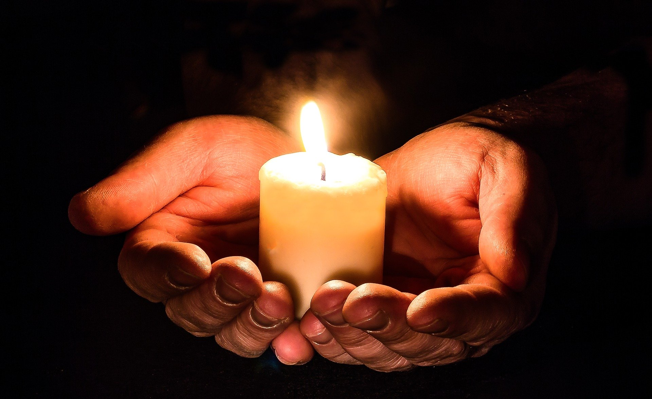
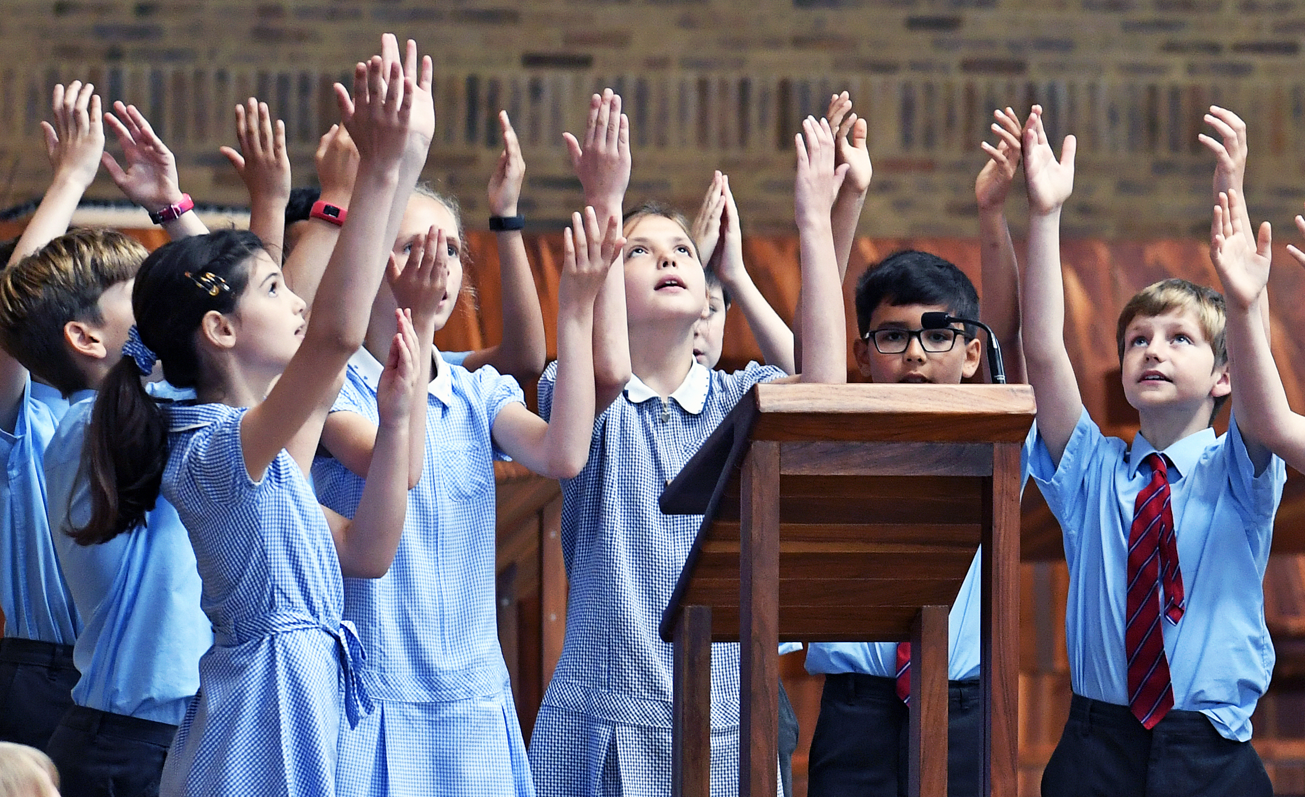
Opening Prayer
Lord our God,
Help us to work together in a spirit of charity and co-operation, accepting wholeheartedly that it is in collaboration that we live out your example and best serve all children in our care
Amen.

Slide 3

A Presentation for Parents & carers
What is RSE / RSHE?
Relationships Education at English Martyrs School
Supporting all pupils
Working with external agencies
Statutory guidance
Sex Education in primary schools
Forming partnerships

Slide 4

Relationships & Sex Education
Health Education has now been added so you will see the acronym RSHE also being used
Programmes that support the teaching & learning of RSHE in the Diocese of Arundel & Brighton
      A Journey in Love
      Life to the Full
      (our chosen programme)
What is RSE?

Slide 5
RSE is the life long learning about physical, moral & emotional development.
It is the understanding of the importance of marriage for family life, stable & loving relationships, respect, love & care.
It is also about the teaching of sex, sexuality & sexual health.
What is RSE?

Slide 6
RSE forms a part of the PSHE, RE and Science Curriculum and is collectively known in Catholic Schools as EPR – Education in Personal Relationships.
Our key objective is the well-being and safety of every pupil.
We believe that parents/carers are the prime educators of their children.
Our role is to support you in the education of your child and not to replace you.
RSE at English Martyrs School

Slide 7
RSE will naturally overlap with PSHE, RE & Science.
In ALL schools teaching MUST reflect the law including the Equality Act 2010.
Schools with a religious character are able to teach their distinctive faith perspective on relationships.
The religious backgrounds of all pupils will be taken into account when planning lessons.
RSE at English Martyrs School

Slide 8
Right to withdraw
Parents/carers have the right to withdraw their children from elements of Sex Education that are not in line with the National Curriculum for Science.
They may not withdraw their children from any elements of Relationships Education and Health Education.

Slide 9
We will ensure that RSE & Health Education is accessible for all pupils including those with Special Education Needs &/or Disability - SEND.
We are aware that some pupils are more vulnerable to exploitation and bullying due to the nature of their SEND and will communicate with parents/carers to tailor content and teaching to their specific needs.
Supporting all pupils

Slide 10
We will ensure that all pupils understand the importance of equality and respect and comply with the relevant provisions of the Equality Act 2010.
We will work in partnership with the family, school and the Church.
Supporting all pupils

Slide 11
We will ensure any outside visitor is familiar with our school ethos and RSHE Policy.
We will ensure all visitor credentials are fully checked.
We will always see materials and lesson plans in advance and ensure they are age-appropriate and accessible to all pupils.
We will ensure that any delivery from an outside visitor will enhance our planned programme.
Working with external agencies

Slide 12
Statutory Requirements by the end of Primary School for Relationships Education
COMPULSORY
All Pupils should know about:
Families and people who care for me
Caring friendships
Respectful relationships
Online relationships
Being safe
Statutory Guidance
Notes:
Families and people who care for me:
that families are important for children growing up because they can give love, security and stability.
the characteristics of healthy family life, commitment to each other, including in times of difficulty, protection and care for children and other family members, the importance of spending time together and sharing each other’s lives
that others’ families, either in school or in the wider world, sometimes look different from their family, but that they should respect those differences and know that other children’s families are also characterised by love and care.
that stable, caring relationships, which may be of different types, are at the heart of happy families, and are important for children’s security as they grow up.
that marriage represents a formal and legally recognised commitment of two people to each other which is intended to be lifelong.
how to recognise if family relationships are making them feel unhappy or unsafe, and how to seek help or advice from others if needed.
Caring Friendships:
how important friendships are in making us feel happy and secure, and how people choose and make friends.
the characteristics of friendships, including mutual respect, truthfulness, trustworthiness, loyalty, kindness, generosity, trust, sharing interests and experiences and support with problems and difficulties.
that healthy friendships are positive and welcoming towards others, and do not make others feel lonely or excluded.
that most friendships have ups and downs, and that these can often be worked through so that the friendship is repaired or even strengthened, and that resorting to violence is never right.
how to recognise who to trust and who not to trust, how to judge when a friendship is making them feel unhappy or uncomfortable, managing conflict, how to manage these situations and how to seek help or advice from others, if needed.
Respectful Relationships:
the importance of respecting others, even when they are very different from them (for example, physically, in character, personality or backgrounds), or make different choices or have different preferences or beliefs.
practical steps they can take in a range of different contexts to improve or support respectful relationships.
the conventions of courtesy and manners.
the importance of self-respect and how this links to their own happiness.
that in school and in wider society they can expect to be treated with respect by others, and that in turn they should show due respect to others, including those in positions of authority.
about different types of bullying (including cyberbullying), the impact of bullying, responsibilities of bystanders (primarily reporting bullying to an adult) and how to get help.
what a stereotype is, and how stereotypes can be unfair, negative or destructive.
the importance of permission-seeking and giving in relationships with friends, peers and adults.
Online Relationships:
that people sometimes behave differently online, including by pretending to be someone they are not.
that the same principles apply to online relationships as to face-to-face relationships, including the importance of respect for others online including when we are anonymous.
the rules and principles for keeping safe online, how to recognise risks, harmful content and contact, and how to report them.
how to critically consider their online friendships and sources of information including awareness of the risks associated with people they have never met.
how information and data is shared and used online
Being Safe:
what sorts of boundaries are appropriate in friendships with peers and others (including in a digital context).
about the concept of privacy and the implications of it for both children and adults; including that it is not always right to keep secrets if they relate to being safe.
that each person’s body belongs to them, and the differences between appropriate and inappropriate or unsafe physical, and other, contact.
how to respond safely and appropriately to adults they may encounter (in all contexts, including online) whom they do not know.
how to recognise and report feelings of being unsafe or feeling bad about any adult.
how to ask for advice or help for themselves or others, and to keep trying until they are heard.
how to report concerns or abuse, and the vocabulary and confidence needed to do so.
where to get advice e.g. family, school and/or other sources.

Slide 13
The focus for all primary schools is Relationships Education
Puberty is now included in Heath Education
SEX Education beyond that stated in the National Curriculum for Science is NOT COMPULSORY
HOWEVER – DfE guidance states …
Statutory Guidance
Sex Education in Primary Schools
Notes:
DfE guidance states ‘In the transition phase (Y6) before moving to secondary school all primary schools should have a Sex Education programme tailored to the age and the physical and emotional maturity of all pupils. It should ensure that both boys and girls are prepared for the changes that adolescence brings and – drawing on knowledge of the human life cycle set out in the national curriculum for science - how a baby is conceived and born.’

Slide 14

Any Questions ?
Opportunity for Group Discussion

Slide 15
WORKING IN PARTNERSHIP
Requirements:
Schools will be required to have a policy; published on the school website. The policy must show how they intend to approach the subject, how they are teaching and the resources they are using and how they will monitor its’ impact.
Schools are now required to consult on their Relationships & Sex Education Policy.
From Sept 2020 schools are also required to teach Health Education BUT they are not required to have a separate policy for this; but may do if they wish.

Slide 16
WORKING IN PARTNERSHIP
We will support you:
In how to talk to your children about Relationships and Sex Education.
By signposting you to age-appropriate resources that can be used at home.
By offering links to what is being taught in school in other areas of the curriculum.

Slide 17
Building strong partnerships with our parents/carers.
Parents/carers understanding what is being taught, when and how.
Helping parents/carers to support their child’s learning at home.
Developing a shared set of values between school and parents/carers.
Dispelling myths around the teaching of RSE and Health Education.
We are committed to

Slide 18
Consultation and feedback when revising or creating polices related to RSE.
Consultation and feedback on the RSE curriculum:
      When it is being taught
      How it is being taught
      What resources are used to support teaching and learning
      Links with outside agencies
What we will ask of you

Slide 19
What this might look like
Information briefings to all parents/carers
Where we will:
Listen
Reassure
Discuss
Gather feedback
        Written
        Face to face
        internet
Notes:
We will ensure:
that the views parents/carers submit will be confidential and only seen and used by designated school staff as part of the engagement process.
that we consider whether aspects of the curriculum may be sensitive to any pupils or to parents/carers
that we will try to resolve any concerns
face-to-face in the first instance
that we will signpost parents/carers to further help and support if requested

Slide 20
The following slides are to help you share information regarding ‘Life to the Full’

Slide 21
“My commandment is this: love one another, just as I have loved you”
John 15:12

Slide 22
Approved by the Diocese and recently updated to include new statutory guidance, the programme teaches that:
The journey begins at the moment of our conception God is at the heart of love
Puberty can be an extremely confusing time for children, our message will be that even in this confusion, God is there
The Sacrament of marriage publicly declares the commitment of each spouse to the other permanently in the acknowledgement that it is God-given
The central message of the Christian faith is love. The central message of our RSHE teaching is love.

Slide 23
The Structure of Life to the Full
The programme is made up of 3 core themes, or ‘modules’:
1) Created and Loved by God
2) Created to Love Others
3) Created to Live in the Community
These modules are then broken down into units to help us deliver the curriculum in a meaningful way that links with our other areas of learning, and will be spread out over the course of the year.

Slide 24
Created and Loved by God explores the individual. Rooted in the teaching that we are created by God out of love and for love, it helps children to develop an understanding of the importance of valuing themselves as the basis for personal relationships
The Three Modules
Early Years to Y6
Created to Love Others explores the individual’s relationship with others. Building on the understanding that we have been created out of love and for love, this Module explores how we take this calling into our family, friendships and relationships, and teaches strategies for developing healthy relationships and keeping safe
Created to Live in Community explores the individual’s relationship with the wider world. Here we explore how human beings are relational by nature and are called to love others in the wider community through service, through dialogue and through working for the Common Good

Slide 25
Unit 1 – Religious Understanding introduces children to the story from the Gospel of Matthew, when Jesus welcomed all of the little children to come to Him. The five-story sessions encourage children to understand that they are created by God out of love and for love. Children will revisit this Gospel story at the end of this Module.
Building on this knowledge, Unit 2 – Me, My Body, My Health encourages children to celebrate similarities and differences between people, including our God-given bodies and the things they enable us to do! Teaching also includes maintaining personal hygiene and the physical differences between boys and girls.
Over the three sessions of Unit 3 – Emotional Well-Being, children will meet presenters Jayden and Josie and fictional character Super Susie. They will help children to understand and articulate their own changing feelings and how other people’s feelings might differ from theirs. Children will learn how they can manage their feelings and about the consequences of their actions.
Unit 4 – Life Cycles returns to the Gospel story from Unit 1, to show that God created us to follow the cycle of life and He loves us at every stage. Children will learn about the specifics of the human life cycle and celebrate how they have already changed and grown.
Key Stage One
Module 1

Slide 26
Unit 1 – Religious Understanding begins with an adapted version of the Prodigal Son story to show children that God loves us, and nothing we can do will stop Him from loving us.
In Unit 2 – Personal Relationships children once again meet Super Susie, who helps them to identify the ‘special people’ in their lives who they love and can trust. In further sessions, children will learn how to cope with various social situations and dilemmas, and the importance of saying sorry and forgiveness within relationships.
In Unit 3 – Keeping Safe, Super Susie helps children to tell the difference between good and bad secrets. This unit also explores the risks of being online by incorporating the ‘Smartie the Penguin’ resources from Childnet, and teaching on physical boundaries, incorporating the PANTS resource by the NSPCC. Through the animated expert Dr Datfa, children will also learn about the effects of harmful substances (including alcohol and tobacco), some basic First Aid, what makes a 999 emergency and what they should do if in an emergency situation.
Key Stage One
Module 2

Slide 27
In Unit 1 – Religious Understanding children will hear the story of The Good Samaritan and will be introduced to the concept of the Trinity – God as a three in one community of love – and think about what the Trinity means for them. This is a simple teaching that we will return to in more complexity in later years. These stories show children that God made us to be in loving relationships with one another.
Unit 2 – Living in the Wider World helps children to learn about the different local and global communities that they are part of, and what rights and responsibilities come with belonging to these communities.
Key Stage One
Module 3

Slide 28
Unit 1 – Religious Understanding explores the Gospel story Jairus’ daughter in various creative and reflective ways. Through story and discussion, children will learn that they are designed for a purpose and how they should live in light of this. A second session unpacks the Sacraments of Baptism and Reconciliation as a foretaste of heaven and a wonderful part of our relationship with God.
In Unit 2 – Me, My Body, My Health, children meet animated character, AJ, who will reappear throughout this scheme of work. In this Unit, children will learn to celebrate similarities and differences, and to appreciate and look after their bodies as gifts from God. Teaching also covers specific physical and emotional changes during puberty, and that growing from boys and girls to men and women is part of God’s loving plan for creation. Unit 3 – Emotional Well-Being helps children to understand the difference between feelings and actions, how to manage them and what they can do to help themselves stay emotionally healthy. In this Unit, media is discussed as a ‘fake reality’ and God’s love for us is presented as a better basis for our self-confidence. Finally, children will identify unacceptable behaviours and learn to build resilience against negative feelings by practising thankfulness.
Returning to the story of Jairus’ daughter from Unit 1, Unit 4 – Life Cycles explores the miraculous nature of human conception and birth and offers an opportunity for thanksgiving. Sexual intercourse is not discussed in this session.
Lower Key Stage 2
(Years 3 and 4)
Module 1

Slide 29
Unit 1 – Religious Understanding tells the parable of The Prodigal Son, showing that God loves us, and nothing we can do will stop Him from loving us. Children will also learn about different types of sin, and the importance of forgiveness in relationships.
The sessions in Unit 2 – Personal Relationships help children to develop a more complex appreciation of different family structures, develop healthy relationships with family and friends and learn some strategies to use when relationships become difficult. Teaching also covers how to recognise discrimination and bullying, both physical and emotional. Children will learn strategies to develop resilience and resist pressure.
Unit 3 – Keeping Safe incorporates some of the excellent NSPCC Share Aware resources, as well as teaching on bullying and physical, emotional and sexual abuse through a series of animated stories. Through the animated expert Dr Datfa, children will also learn in greater depth about the effects of drugs, alcohol and tobacco and how to make good choices concerning these as they get older. The final session of the Module explores in more detail what to do in emergency situations.
Lower Key Stage 2
(Years 3 and 4)
Module 2

Slide 30
Lower Key Stage 2
(Years 3 and 4)
Module 3
Unit 1 – Religious Understanding explores in greater detail the community aspect of the Trinity and encourages children to think about what the Trinity means to them and how as they were made in God’s image, they too are created to live in community.
In Unit 2 – Living in the Wider World, children will learn some of the principles of Catholic Social Teaching from Together For The Common Good, which will help them to live in communities in the way God intends. Teaching includes the common good, the human person, social relationships and stewardship.

Slide 31
Unit 1 – Religious Understanding explores the Gospel story of the ‘Calming of the Storm’ (from Matthew, Mark and Luke). Over five story sessions, children will consider experiences of change, growth and development, and the trust that they can have in the person of Jesus through times of trial and tribulation. This is the religious and spiritual foundation for the exploration throughout the rest of the work covered in Module 1: Created and Loved By God.
In Unit 2 – Me, My Body, My Health, children will learn that celebrating differences between people is enriching to a community and know that their self-confidence should arise from being loved by God. They will learn about the physical changes that boys and girls go through during puberty and how they should respect and take care of their bodies as gifts from God. Genitals are also mentioned here, but not named and identified. Continuing through the Paradise Street series, Unit 3 – Emotional Well-Being helps children learn about pressures that they may experience from themselves, others and the media. Children will develop ideas on how to build resilience through thankfulness, use simplified CBT techniques to manage their thoughts, feelings and actions and cope with new or difficult feelings such as romance and rage. The final session in this Unit covers how children may be affected by what they see online, including pornography (Year 6 only)
In Unit 4 – Life Cycles, children will learn about God’s design for creating new life through a more nuanced understanding of menstruation, fertility, conception, fetal development in the womb and childbirth. An optional session talks about sexual intercourse within the context of marriage being God’s plan for the place of sex within a relationship. (Year 6 only)
Upper Key Stage 2
(Years 5 and 6)
Module 1

Slide 32
Unit 1 – Religious Understanding explores the nature of God’s call to love others. Children will study and reflect imaginatively on the story of Zacchaeus’ conversion and explore ways in which they can hear God’s call in their lives.
Through a series of short sketches from presenters Zoe and Joey, Unit 2 – Personal Relationships aims to equip children with strategies for more complex experiences of relationships and conflict. This includes sessions that help children to identify and understand how to respond to spoken and unspoken pressure, the concept of consent and some practical demonstrations of this and further teaching on how our thoughts and feelings have an impact on how we act.
Unit 3 – Keeping Safe builds on the NSPCC Share Aware resources used in Lower Key Stage Two, equipping children to make safe and sensible decisions about what online content they should/shouldn’t share, cyberbullying and how to report and get help if they encounter inappropriate messages or material. The third session in the Unit moves into the real world and considers the four types of abuse: sexual, physical, emotional and neglect. Children will know how to spot each type of abuse and who they can go to for help. (Year 6 only)
The final three sessions in this Module explore how drugs, alcohol and tobacco can negatively affect people’s lifestyles and the body’s natural functioning, discuss how to make good choices even in pressured situations, and teach essential First Aid such as DR ABC and the recovery position.
Upper Key Stage 2
(Years 5 and 6)
Module 2

Slide 33
Unit 1 – Religious Understanding deepens pupils understanding and appreciation of the three-part community of love, the Trinity, with the endpoint of discussing the Trinity as it might be communicated in a church setting. Children will learn that the Trinity demonstrates the perfect loving community, and we are called to emulate this self-giving and self-sacrificing love in our communities.
Building on learning from Lower Key Stage Two, Unit 2 – Living in the Wider World teaches children some of the principles of Catholic Social Teaching from Together For The Common Good, which will help them to fulfil their purpose of making a difference in the world around them. Teaching includes the common good, the human person, social relationships and stewardship.
Upper Key Stage 2
(Years 5 and 6)
Module 3

Slide 34
Any Questions ?
Please contact Dr Townsley or Mrs Dryden.
Opportunity for Group Discussion

Slide 35
www.abdiocese.org.uk/education

