Slide 1

Welcome to Year 4
Class Teacher: Miss Herod
Teaching Assistant: Mrs Wickens

Slide 2
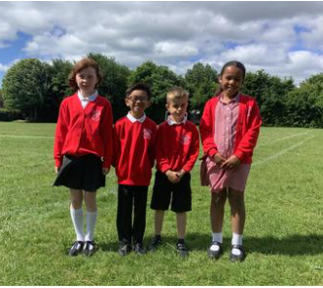
School uniform
Information about school uniform and the details of our supplier can be found on the website (under ‘Parents’ and ‘uniform’). Please note:
We have added a picture of what are considered appropriate ‘school shoes’ - boots are not included, and trainers should only be worn on PE days
Longer hair should be tied back with simple hair accessories in the school colours
The school does not allow children to have hair styles that could be distracting for other children.
Earrings should be plain studs only
For PE, children should wear red PE shorts or navy jogging bottoms. Leggings, cycle shorts or tights underneath shorts should not be worn
If you have any queries about school uniform, please get in touch with Dr. Townsley via the school office.

Slide 3
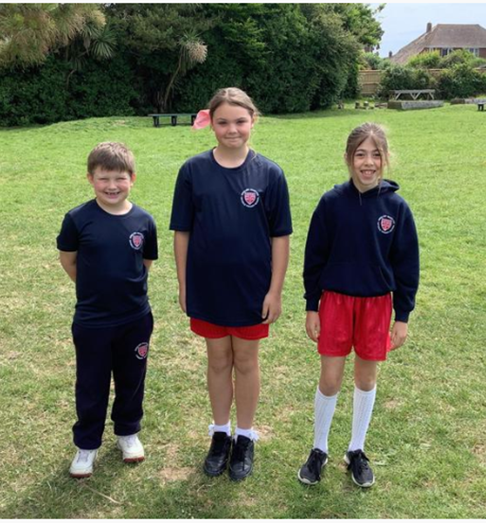
PE days are Monday and Wednesday.
Children should come to school in PE kits.

Slide 4
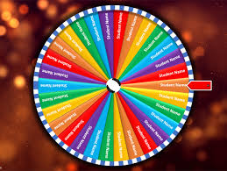
School uniform reward
We will be continuing with the ‘Wheel of Names’ where children wearing the correct uniform have a chance to win a treat of their choice (hot chocolate, smoothie or milkshake).
You’ve got to be in it to win it!

Slide 5

Attendance and Punctuality
We all want the very best for your child, and for us to do our best for them they need to be here as often as possible and to be punctual.
Key things to note are that:
You should try to book any medical appointments for your child (e.g. optician, dentist) out of school time. Proof of appointment times should be sent in with the request.
All requests for absence or time out of school for appointments should be made via an absence request form.
Family holidays in term time will not be authorised and if a child has more than 10 sessions of unauthorised absence in 10 weeks, referrals will be made for Fixed Penalty Notices.
Gates are closed and the register is taken at 8.50. If your child is late, they must be taken to the office by an adult to sign them in.

Slide 6


Safeguarding
In our school community, we are all fully committed to safeguarding your children so that they can thrive and achieve their full potential.
The NSPCC has some great resources for parents, from the PANTS campaign (with the wonderful Pantosaurus song) to the Be Share Aware campaign. internetmatters.org is also a great starting point with an ABC online safety checklist and age specific advice. If you need any further advice, please do ask us.

Slide 7
Yearly Topic Overview
Autumn – Footprints in the sand
Spring – Ancient Greeks
Summer- The Ancient Romans

Slide 8
Year 4 class showcase
Please join us!
17th November
5th February
2nd June

Slide 9
Positive behaviour
In our school, we want to make sure that all of our children are supported and encouraged to be:
ready (to make the most of all opportunities in school and allow others to do the same)
respectful (to all members of the school and wider society)
safe (through showing protective behaviours towards themselves and others)
Learning about appropriate behaviours is like all learning in school – there are good days and not so good days. Some children will find it easy to follow behaviour expectations, others may require additional support and understanding.

Slide 10
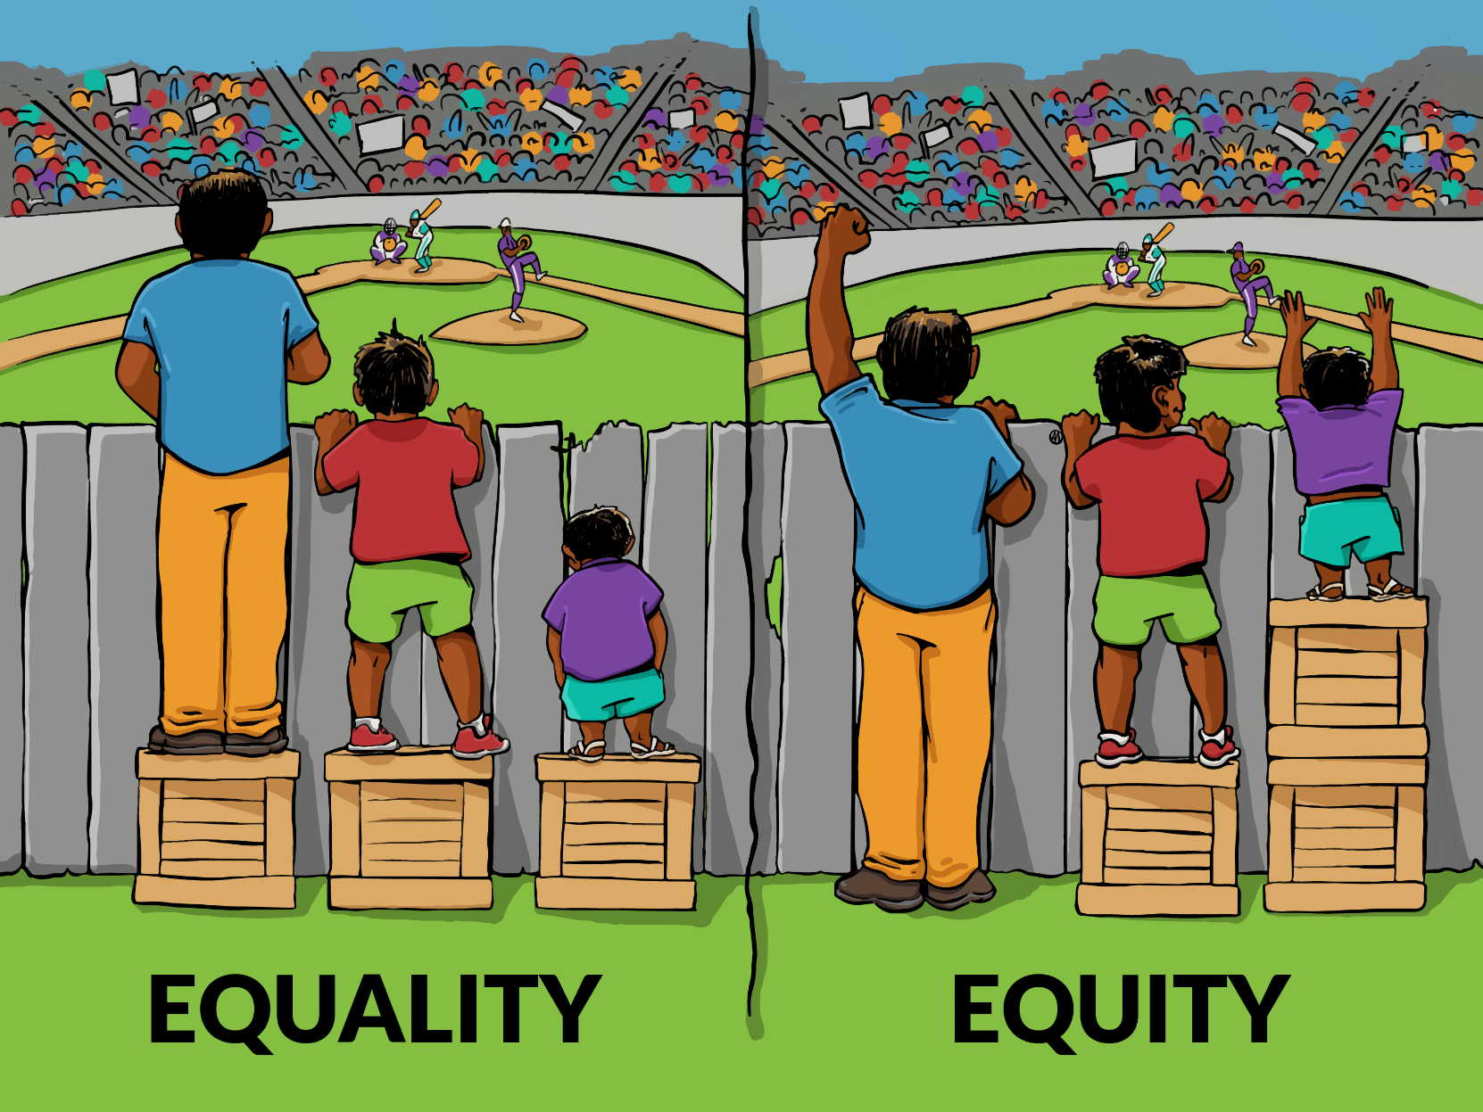
Our goal is not that children are treated equally but that they are treated with equity so that they can access opportunities, thrive and become the people that God intended them to be.
This may mean that some of our children may need more chances, more understanding, time out, shorter tasks, more patience and tolerance … as a Catholic school we are invested in every individual. There may be times that other children may perceive this as ‘unfair’ – “Why didn’t I get a box?” - but we are aiming towards developing a shared understanding across our school that true fairness is when everyone gets what they need.

Slide 11

Times tables
In June, your children will complete a government issued times tables test. This is all tables up to 12x12. They will complete this on a computer.

Slide 12

S[pellings
Children are all sent home with paper copies of the spellings they need to learn, they will also have games set on SpellingShed.

Slide 13

Reading
All children have a reading record, they can write in this themselves when they have read, some children will make a comment about the book, some will draw a picture.

Slide 14
Homework
Alongside the termly homework sheet (set on bromcom, this Friday), children are also set spellings on spelling shed, times tables on TTRS and expected to read at home. We have in class reward charts to encourage this.

Slide 15

Snack time
All snacks should either a fruit of vegetable. This is in line with the school’s policy.

Slide 16

Questions?
Thank you for coming.
year4@englishmartyrs.school

