Slide 1
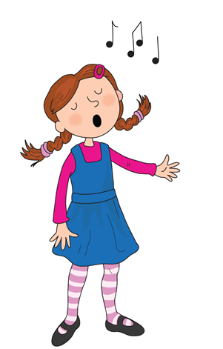

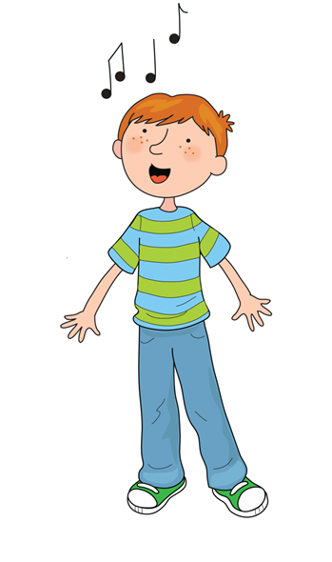
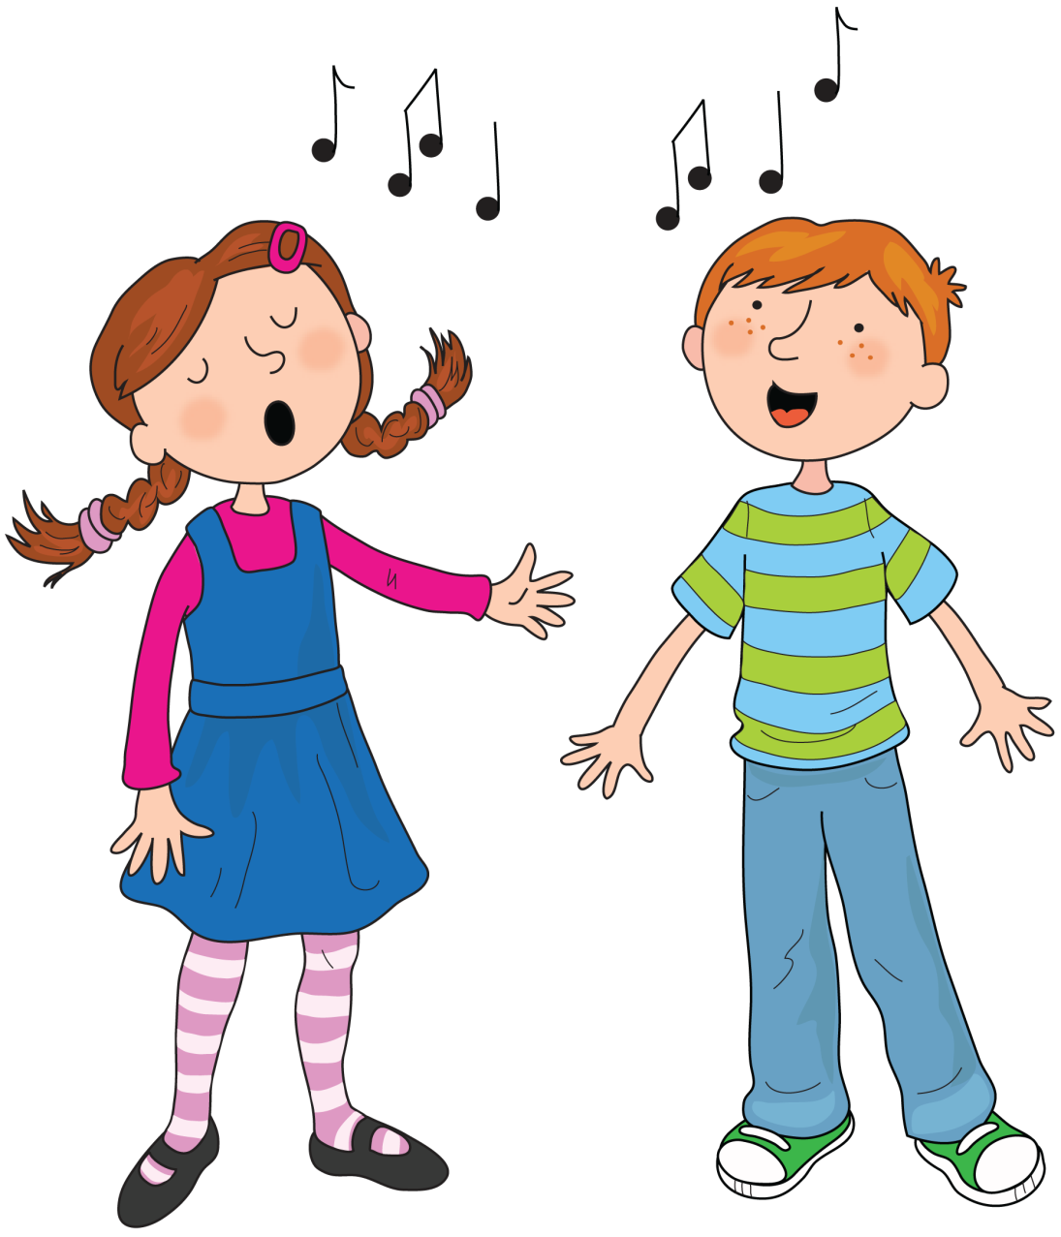

Song of Sounds

Slide 2

We can sing a song of sounds, skip to my lou my darling

Slide 3

Train in the rain ai ai ai

Slide 4
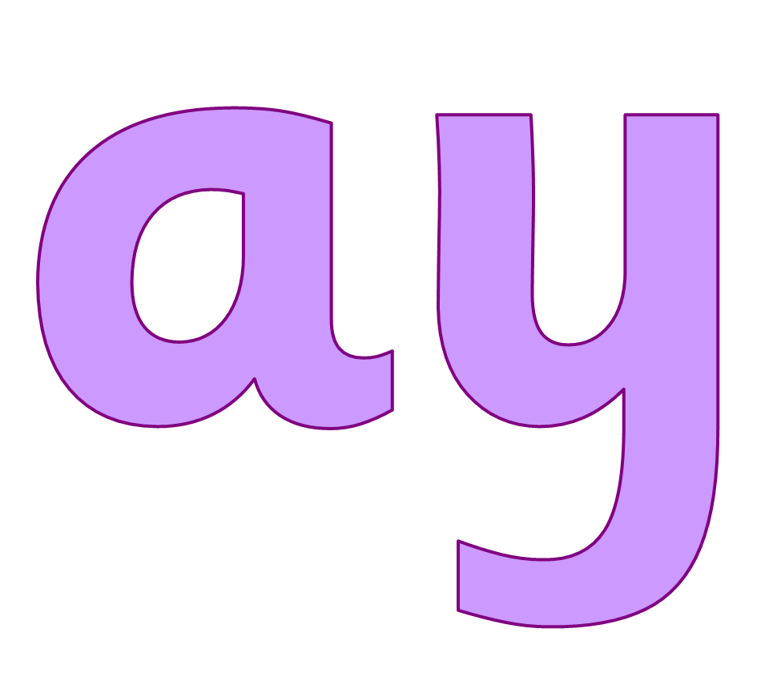
May I play ay ay ay

Slide 5
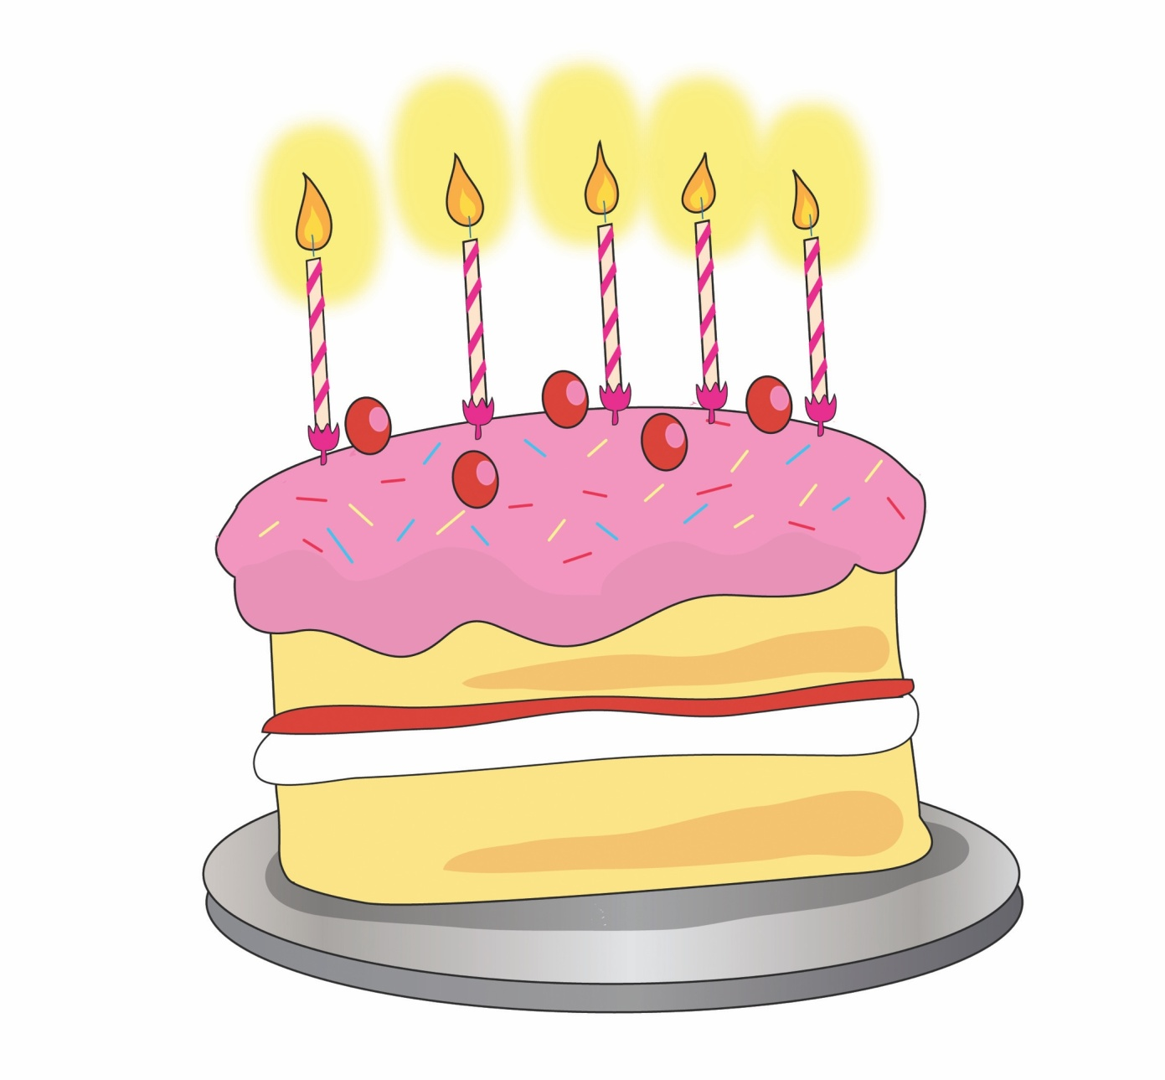

Bake a cake a-e a-e a-e

Slide 6
Skip to my lou my darling

Slide 7
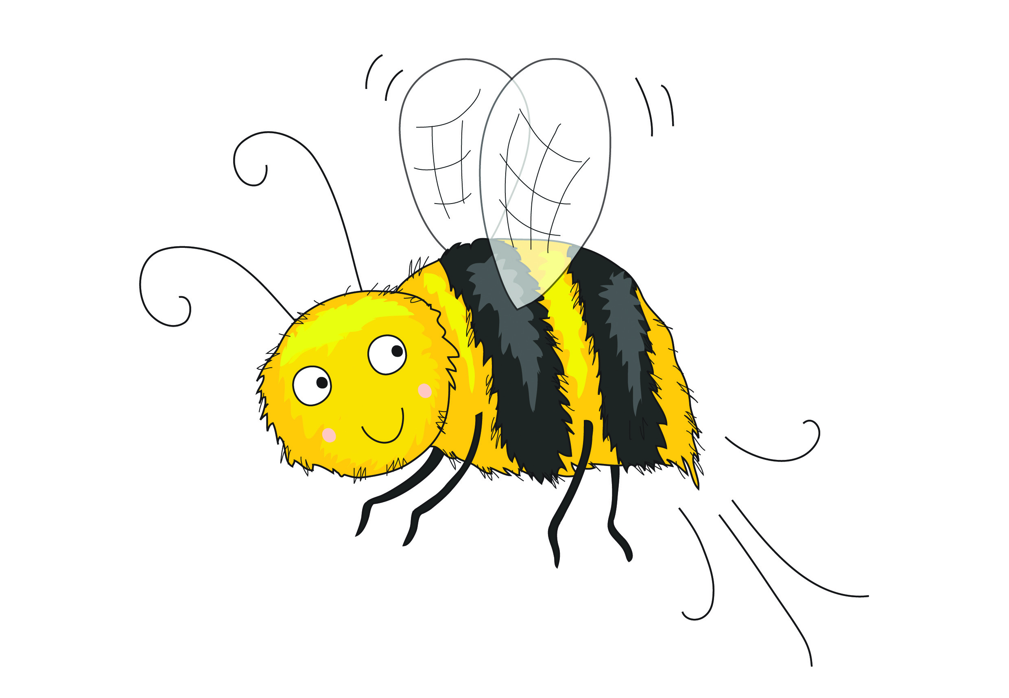

Busy busy bee ee ee ee

Slide 8

Beans in your dreams ea ea ea

Slide 9
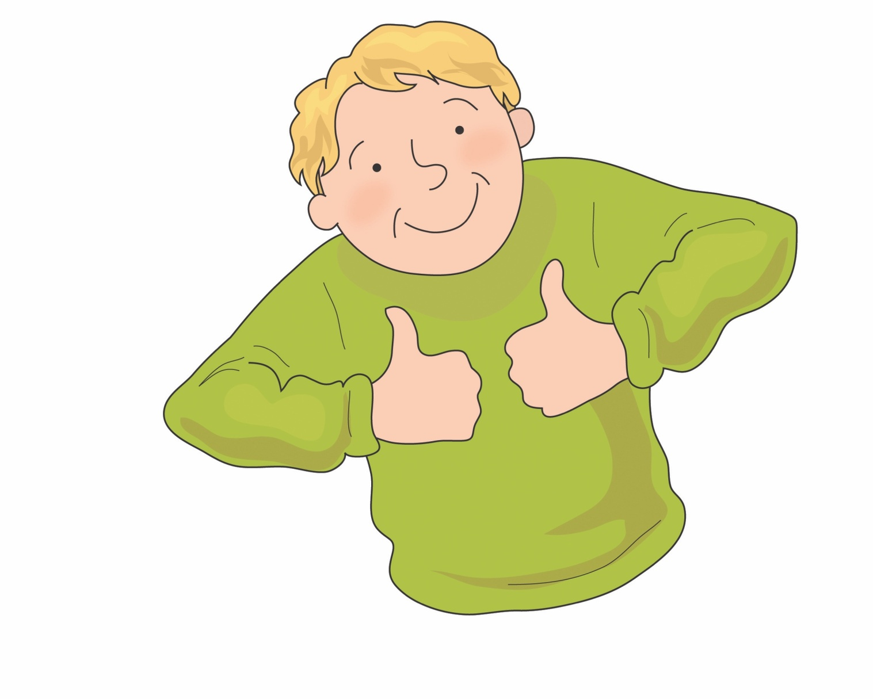

Perfect Pete e-e e-e e-e

Slide 10
Skip to my lou my darling

Slide 11


Soar up high igh igh

Slide 12
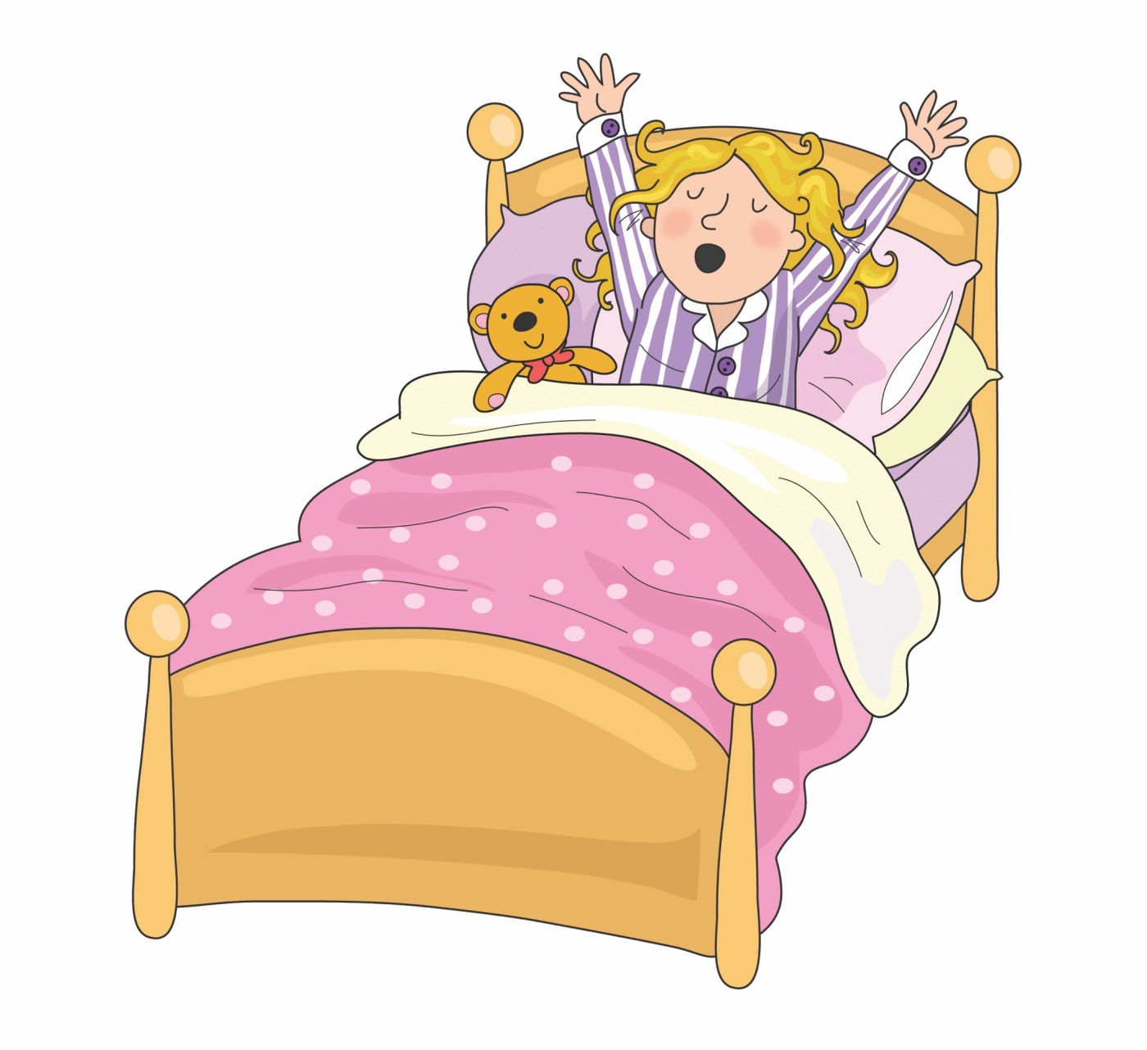

Lazy lie in ie ie ie

Slide 13

In a while crocodile i-e i-e i-e

Slide 14
Skip to my lou my darling

Slide 15
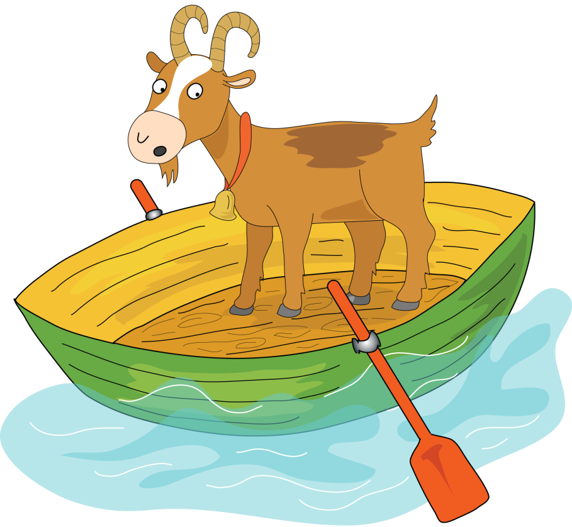

Goat on a boat oa oa oa

Slide 16

Throw the snow ow ow ow

Slide 17
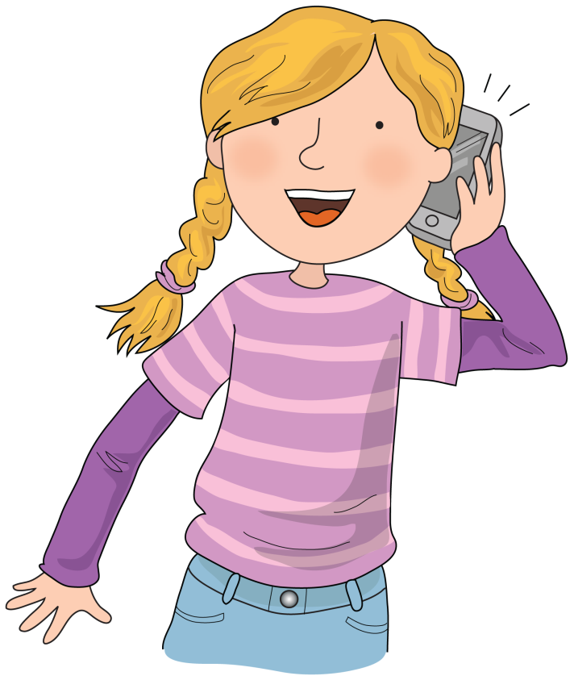

Phone home o-e o-e o-e

Slide 18
Skip to my lou my darling

Slide 19

Zoom to the moon oo oo oo

Slide 20
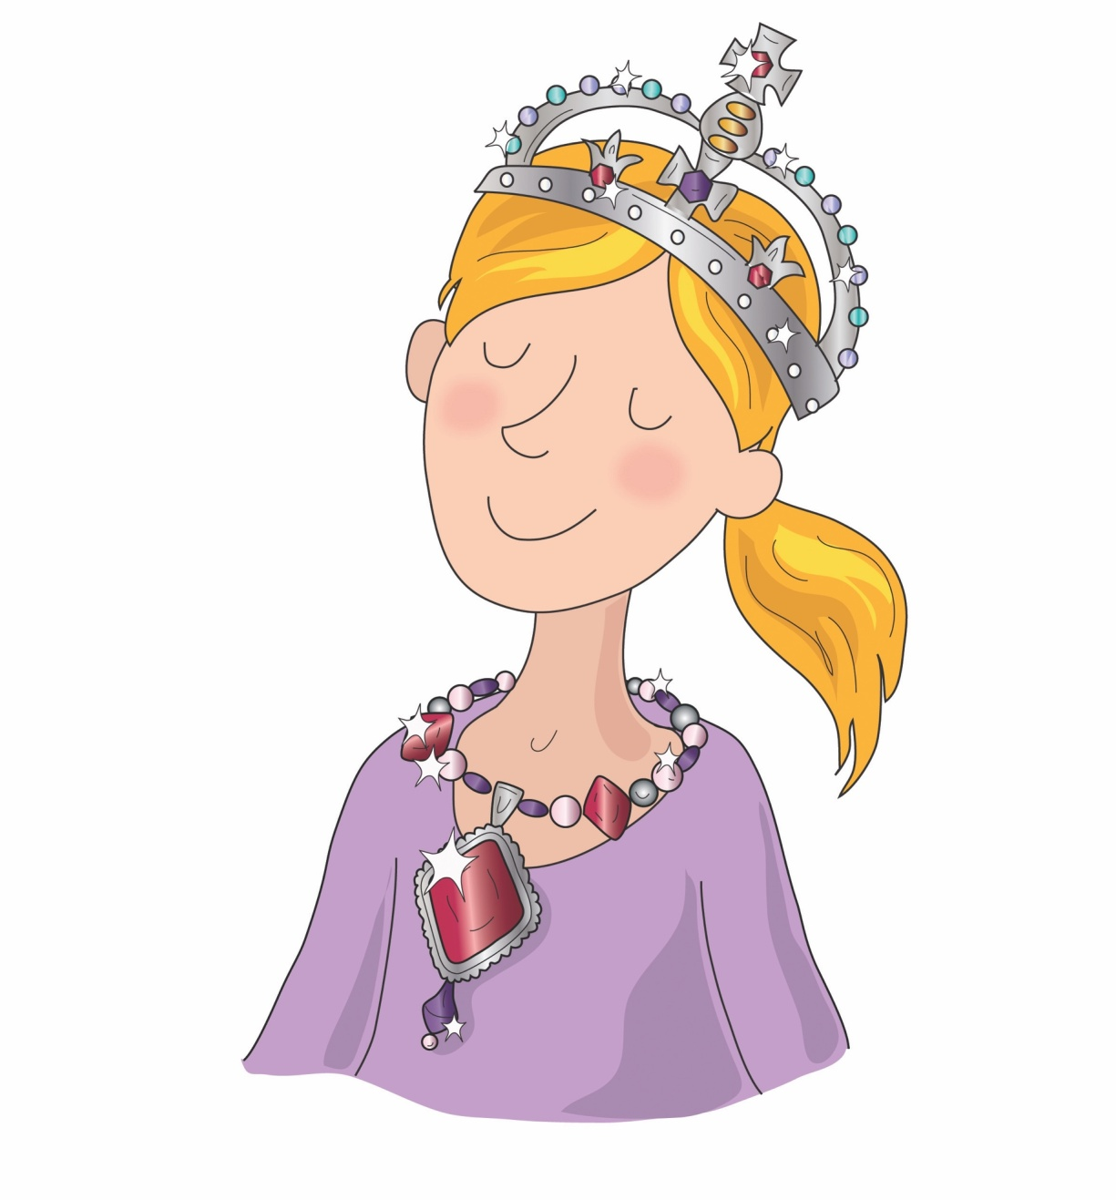

New jewels ew ew ew

Slide 21
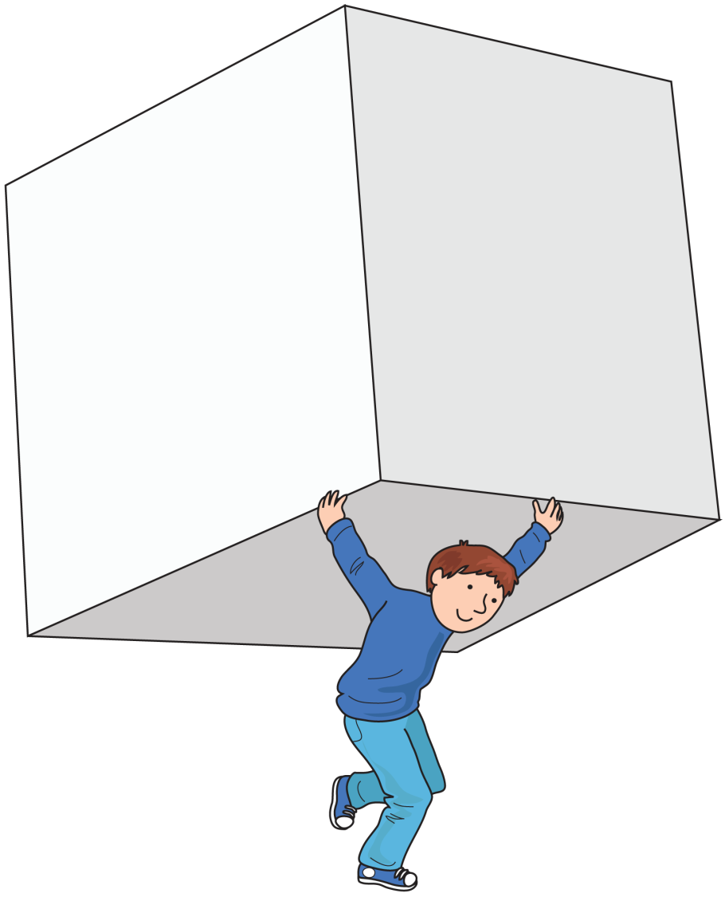

A huge cube u-e u-e u-e

Slide 22
Skip to my lou my darling

Slide 23
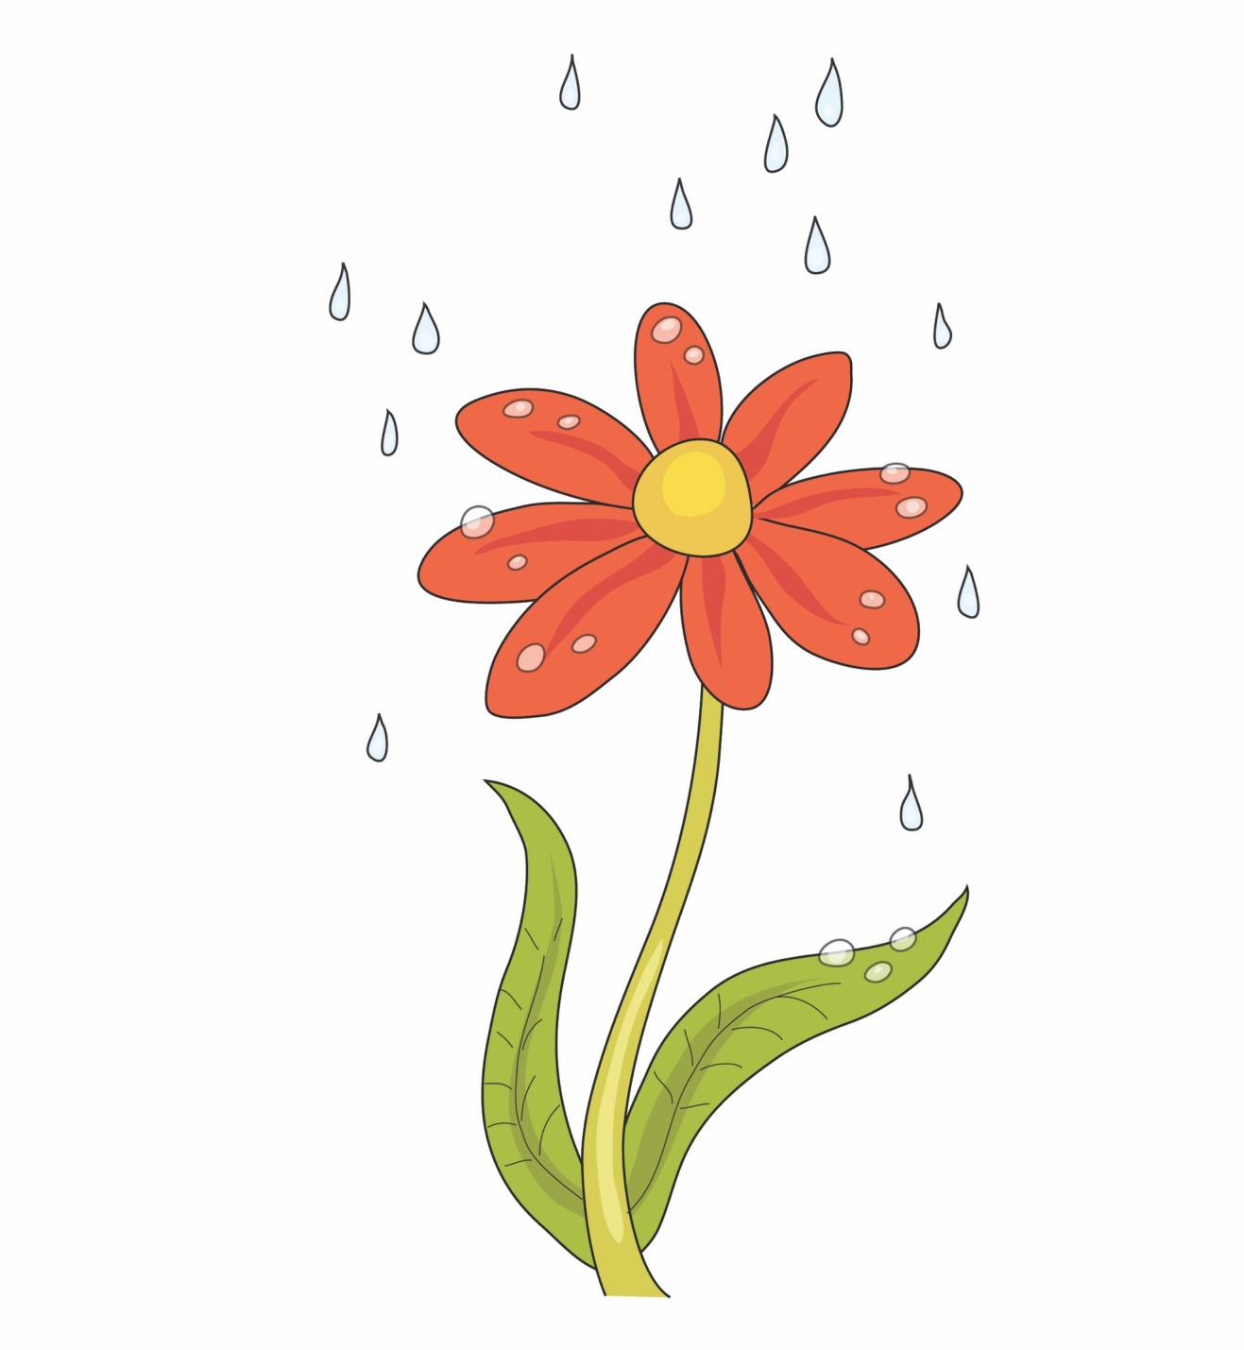

Flower in a shower er er er

Slide 24

If you’re hurt see a nurse ur ur ur

Slide 25

Girl in a whirl ir ir ir

Slide 26
Skip to my lou my darling

Slide 27
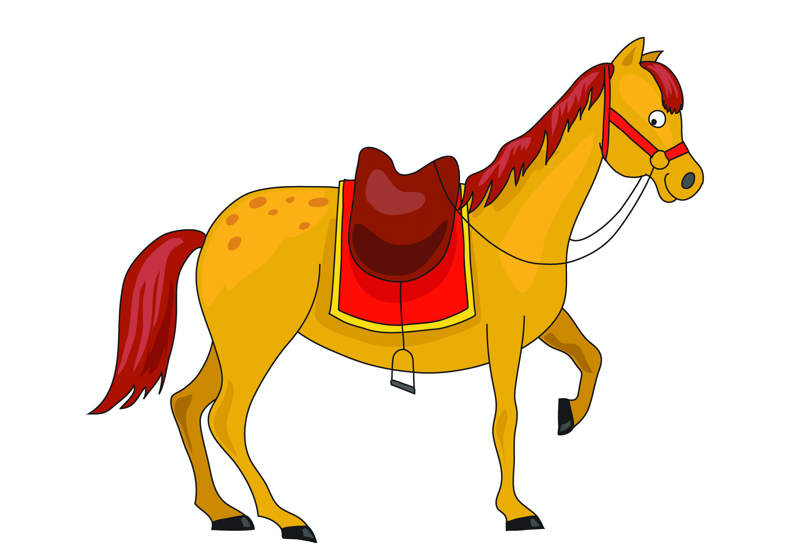

It’s a horse of course or or or

Slide 28
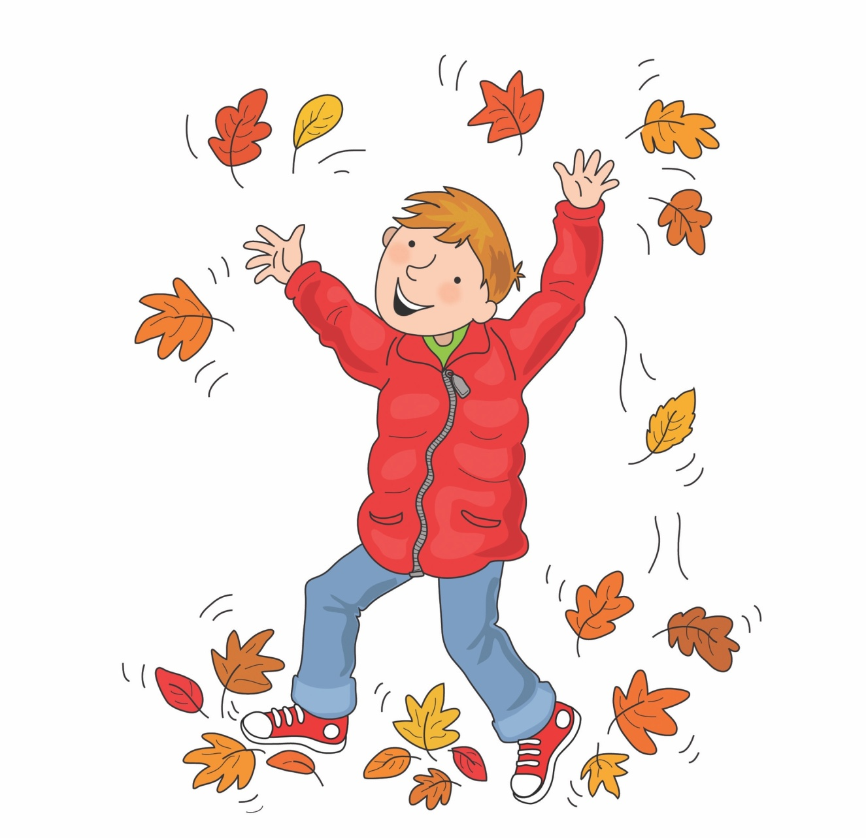

Naughty in autumn au au au

Slide 29
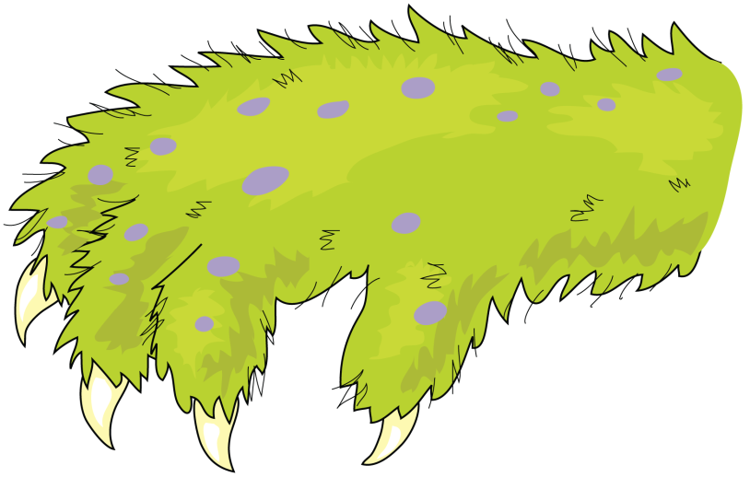

It’s an awful claw aw aw aw

Slide 30
Skip to my lou my darling

Slide 31
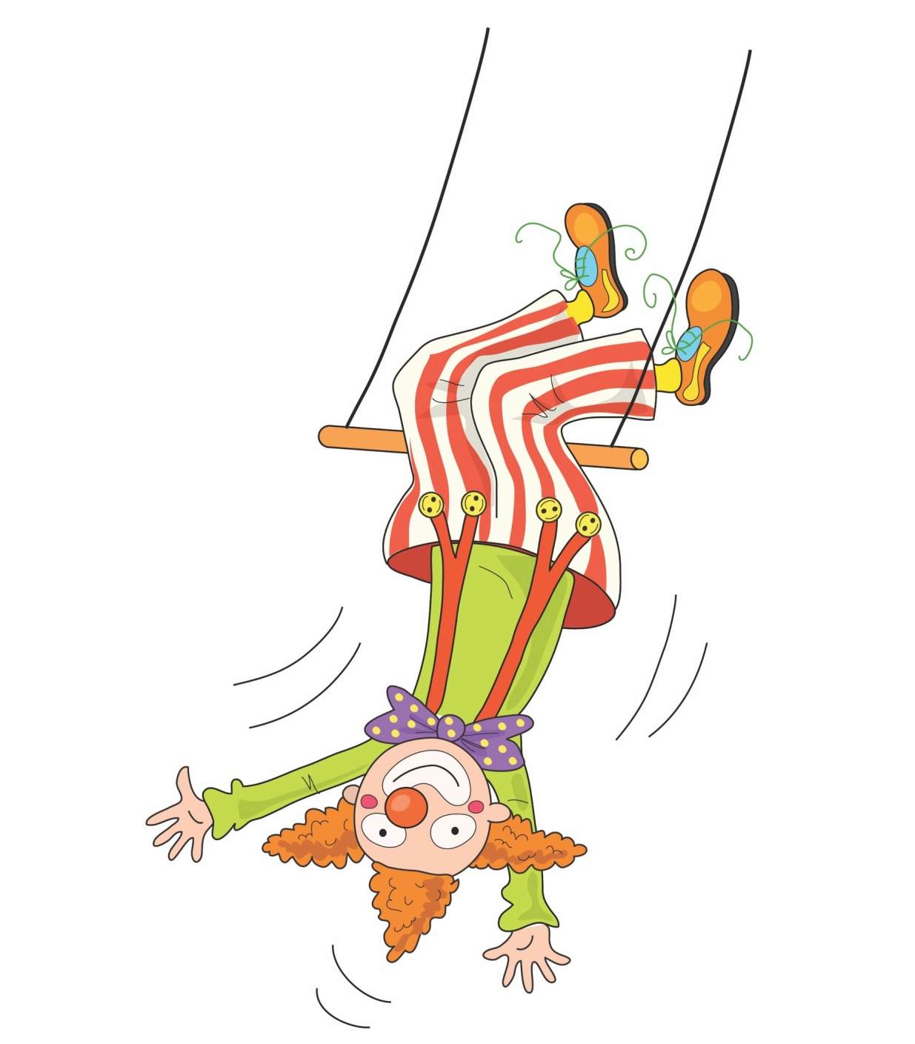
Clown upside down ow ow ow

Slide 32
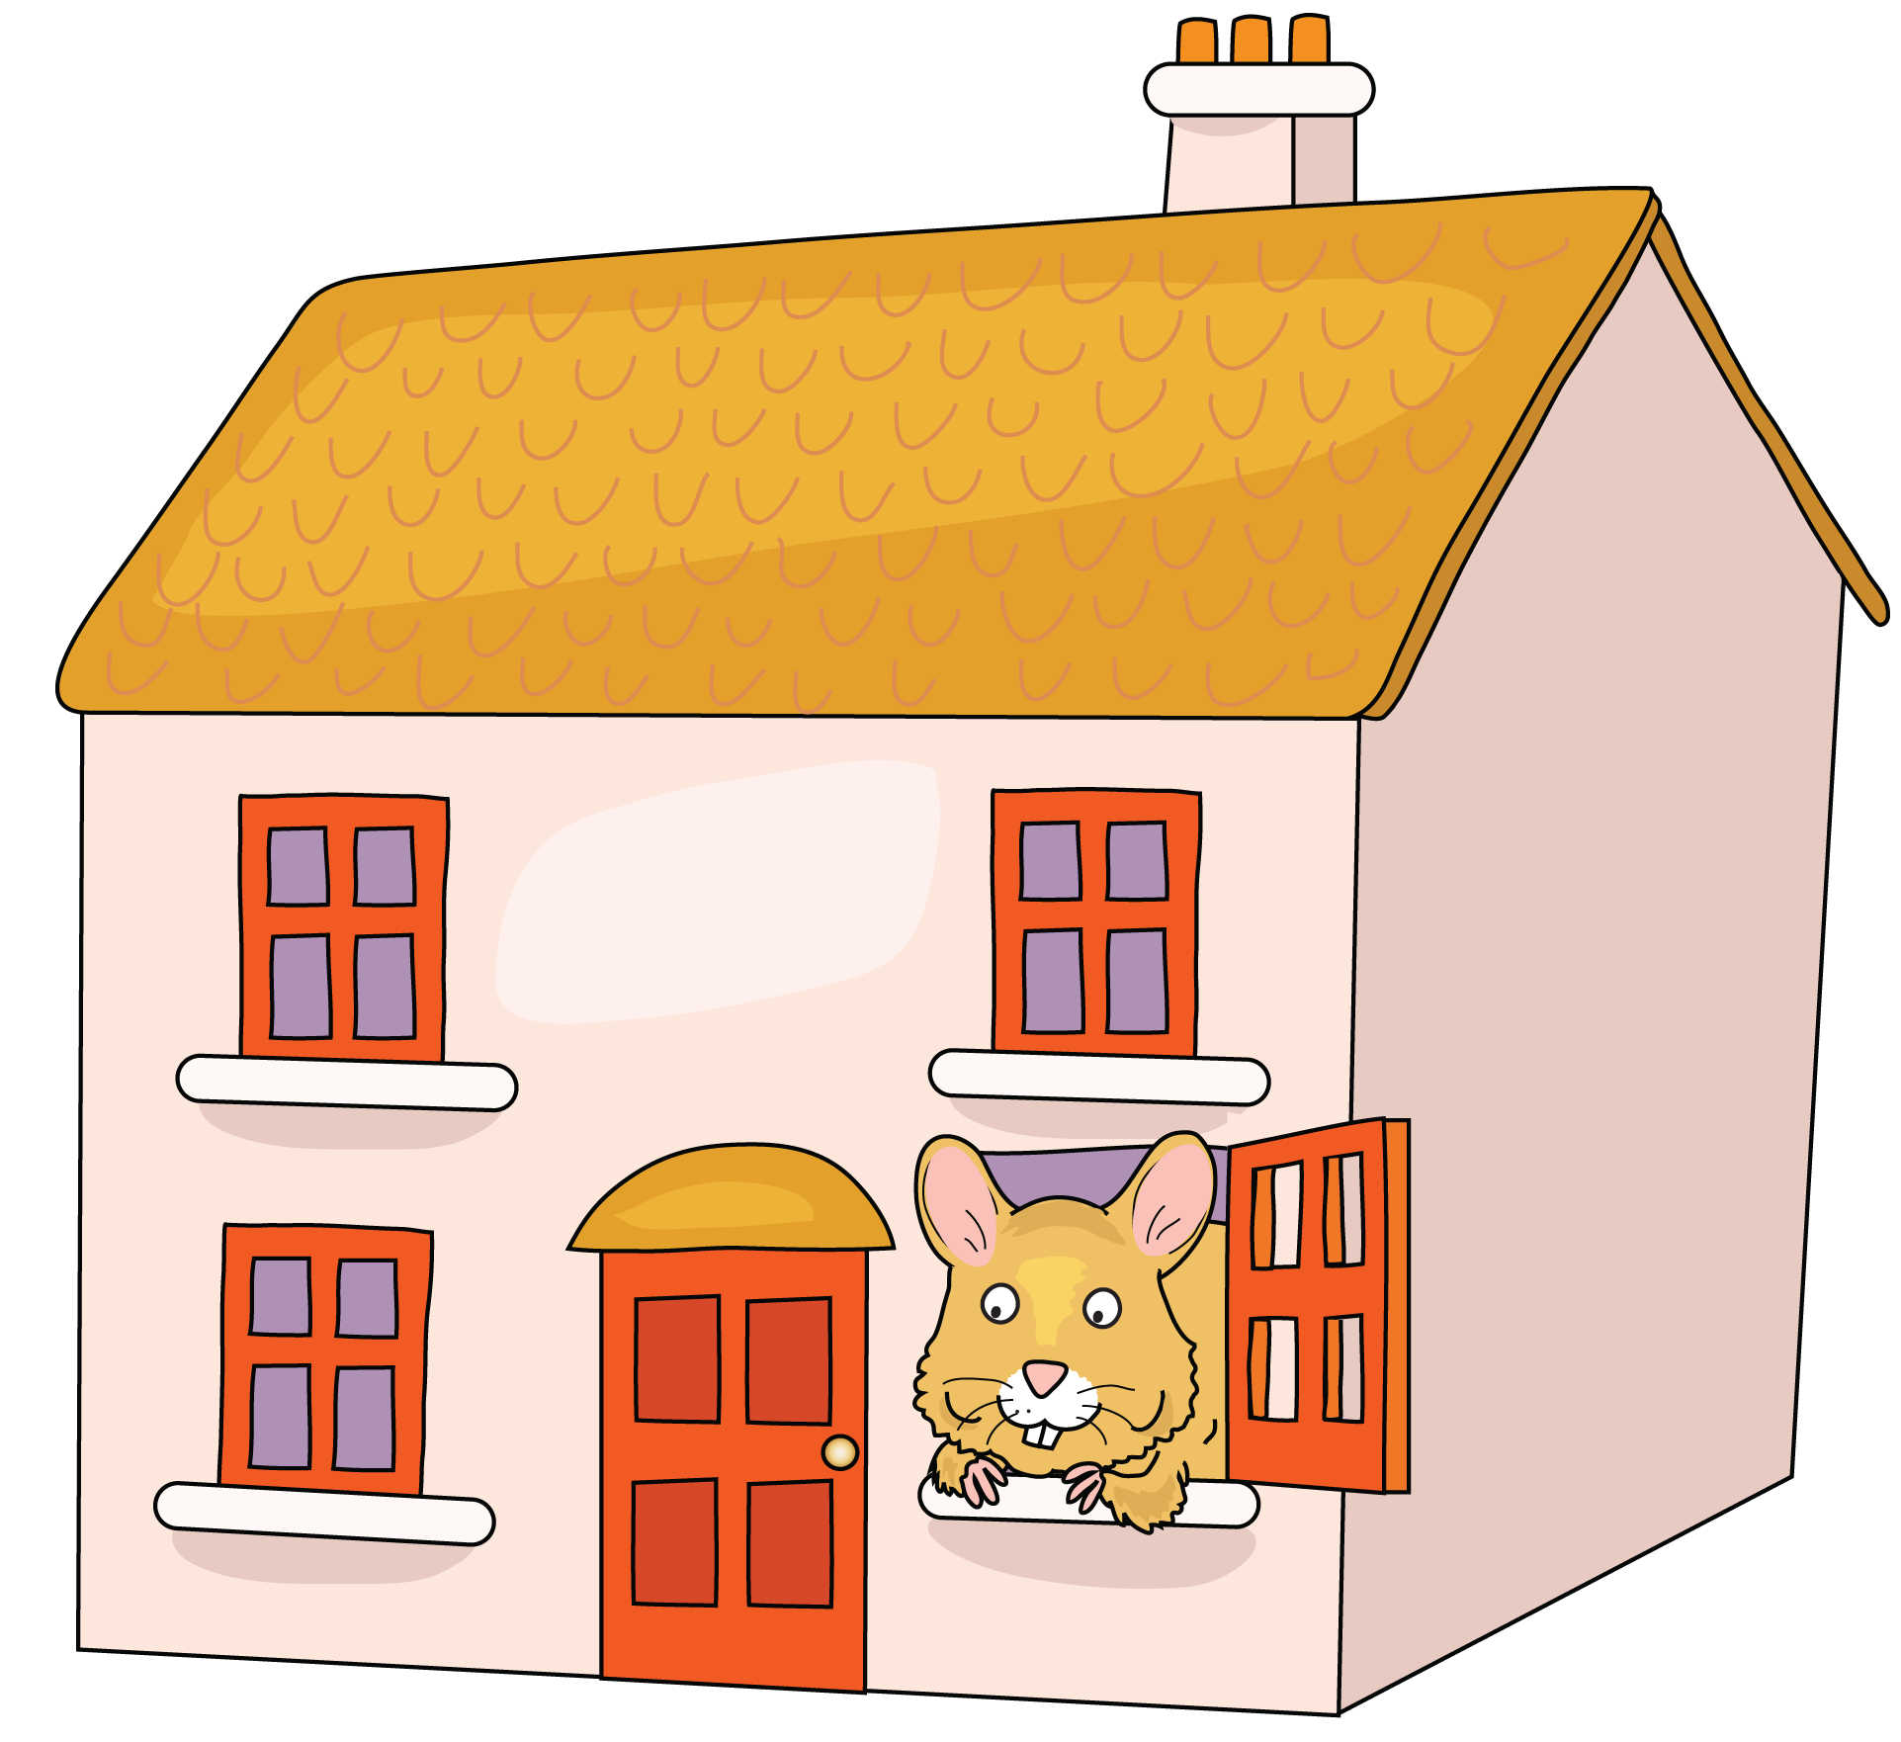

Mouse in a house ou ou ou

Slide 33
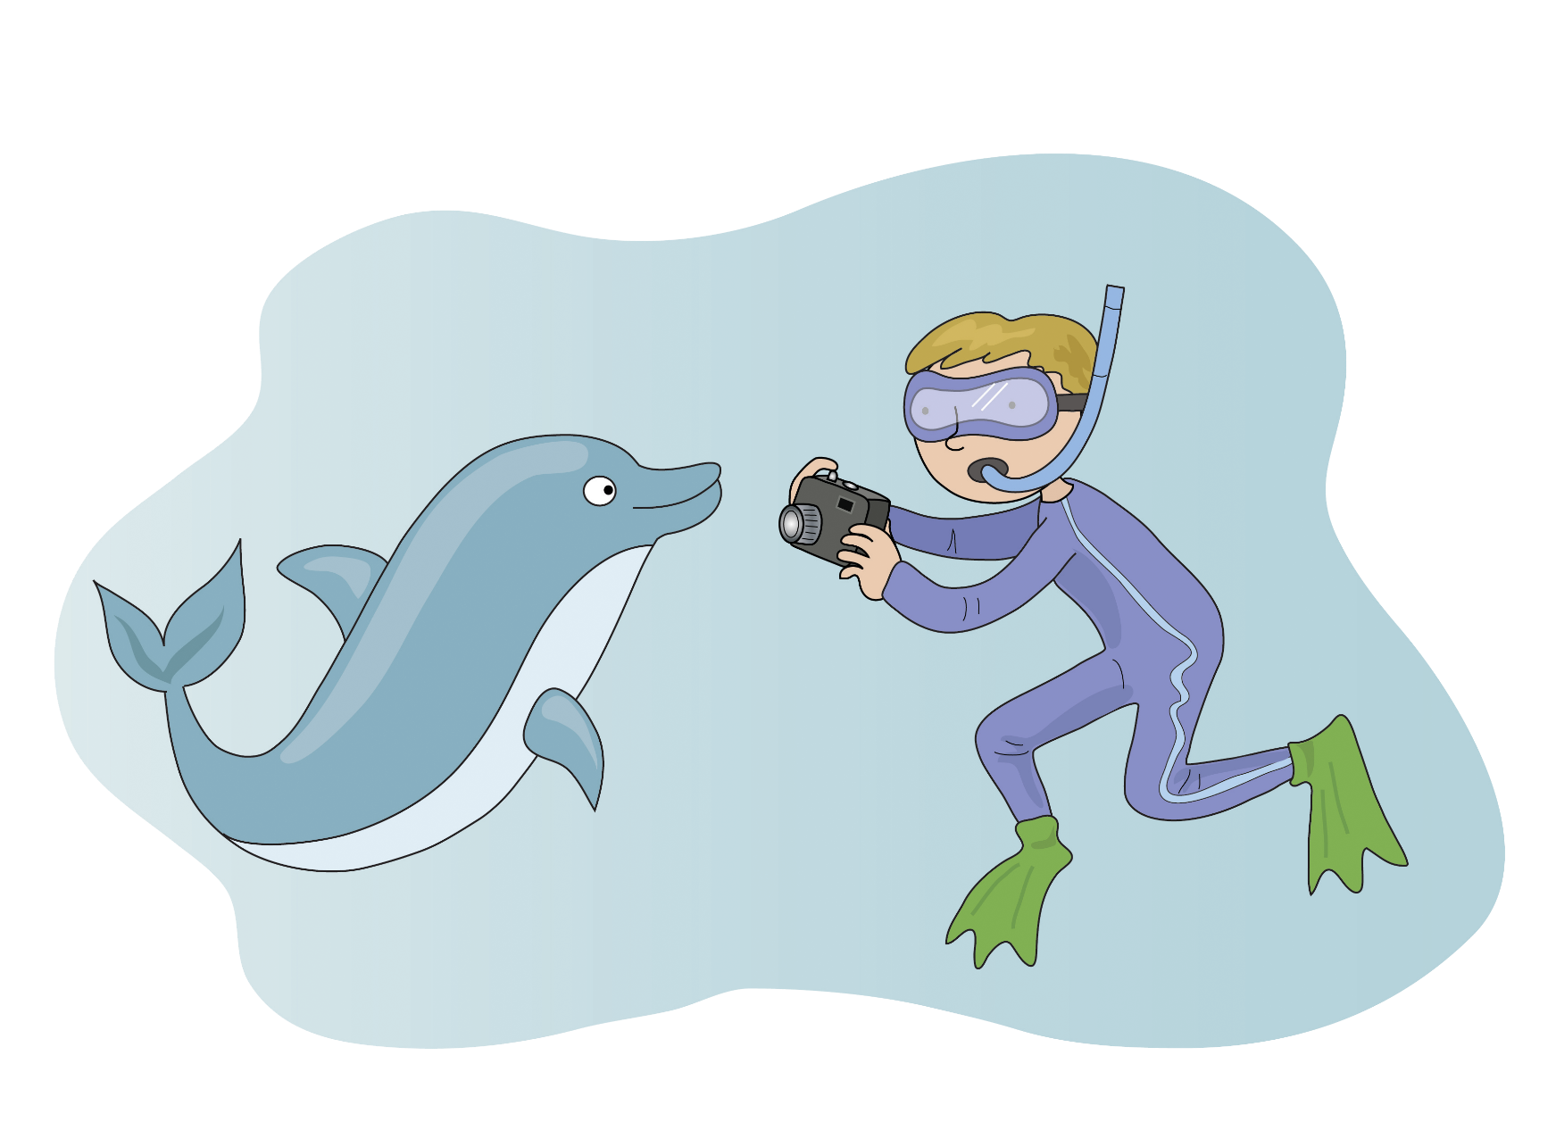

Photograph a dolphin ph ph ph

Slide 34
Skip to my lou my darling

Slide 35

Don’t be noisy oi oi oi

Slide 36
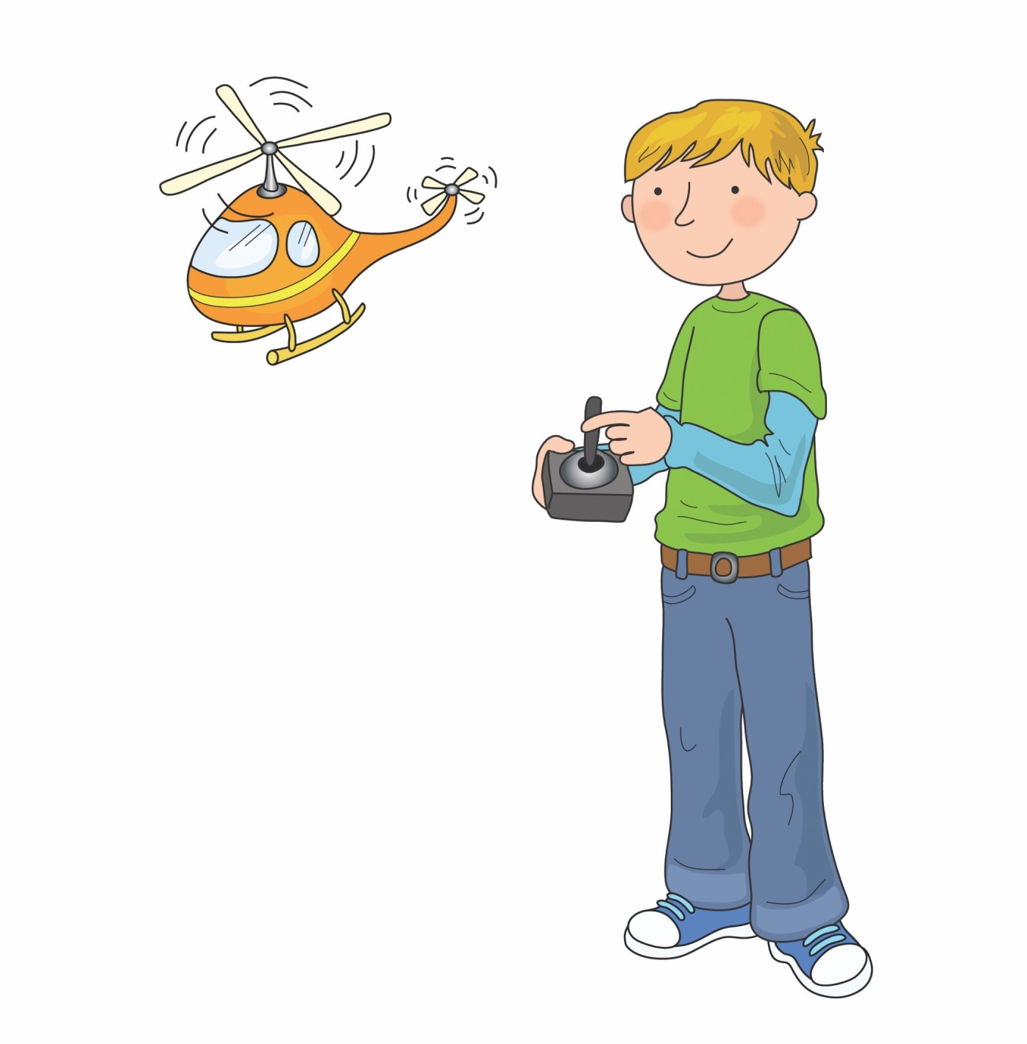

Boy with a toy oy oy oy

Slide 37


What where and when wh wh wh

Slide 38
Skip to my lou my darling

Slide 39
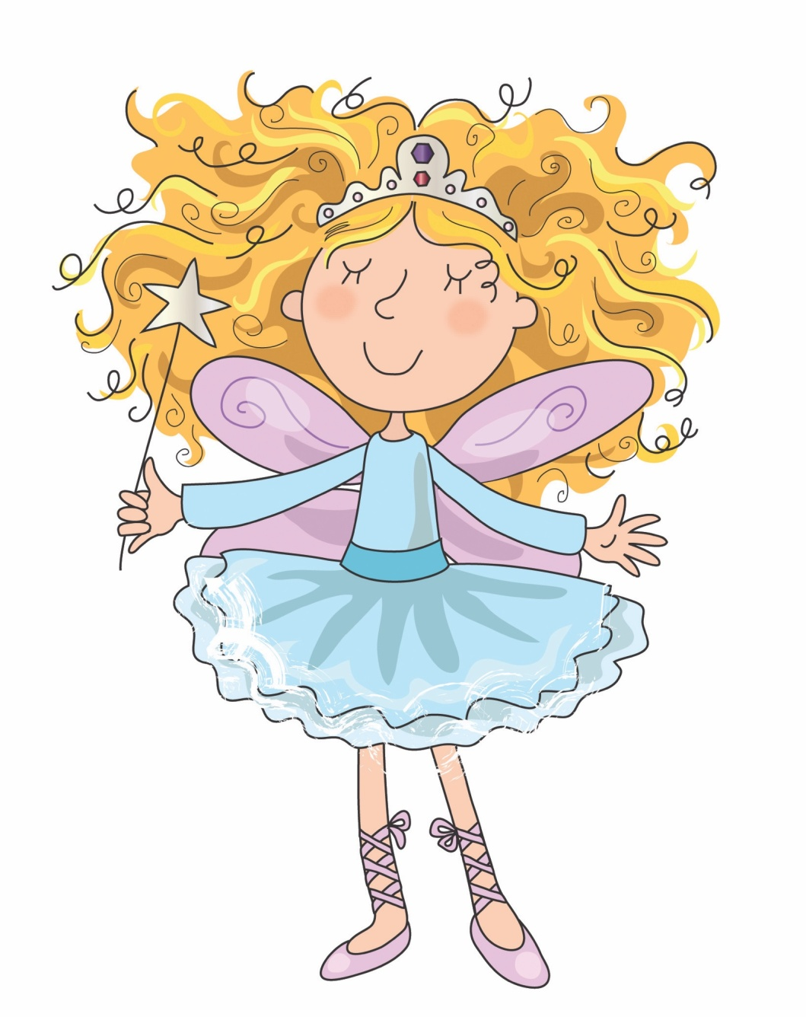

Hairy fairy air air air

Slide 40
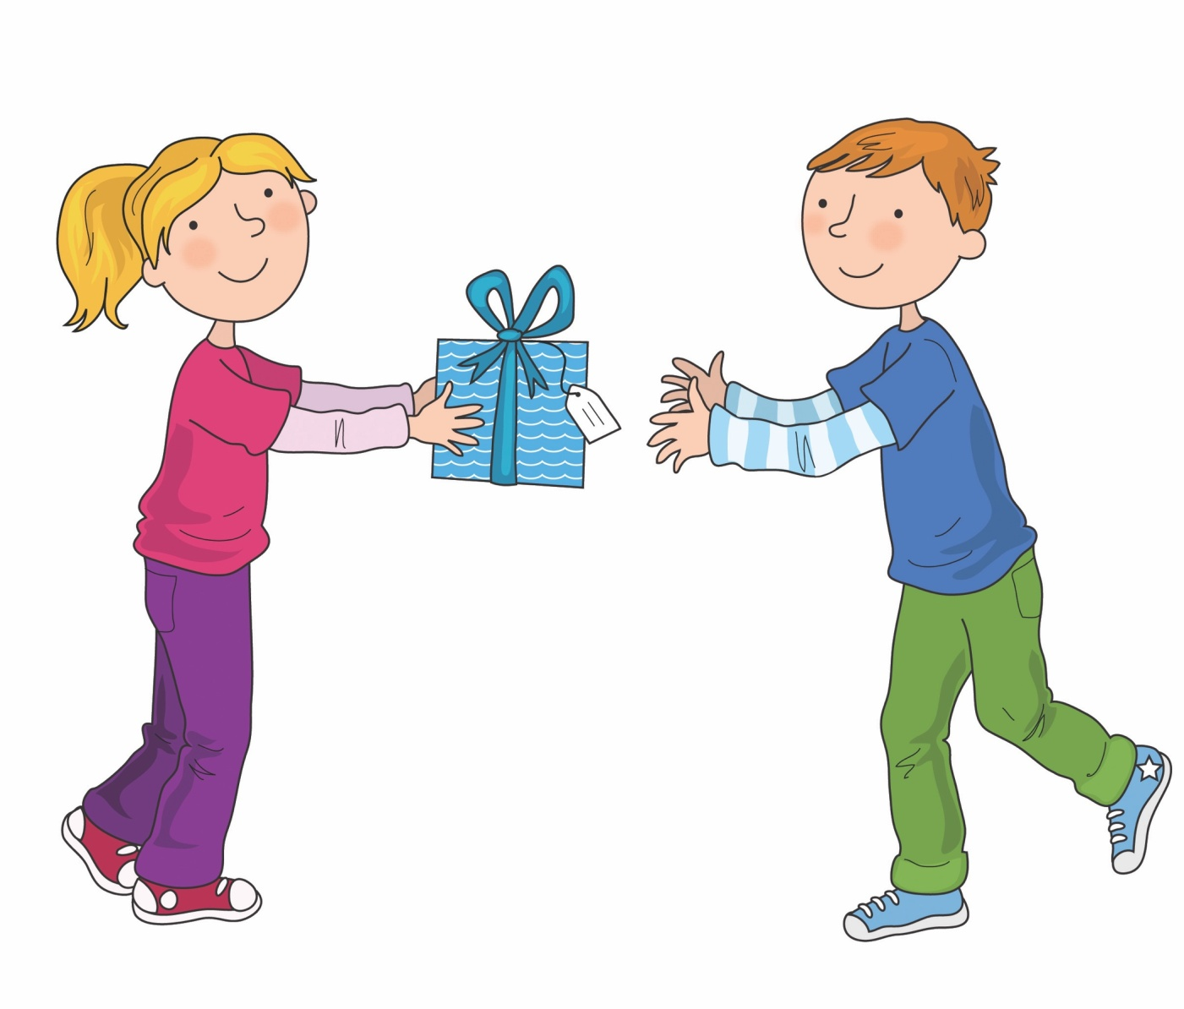

Share if you care are are are

Slide 41
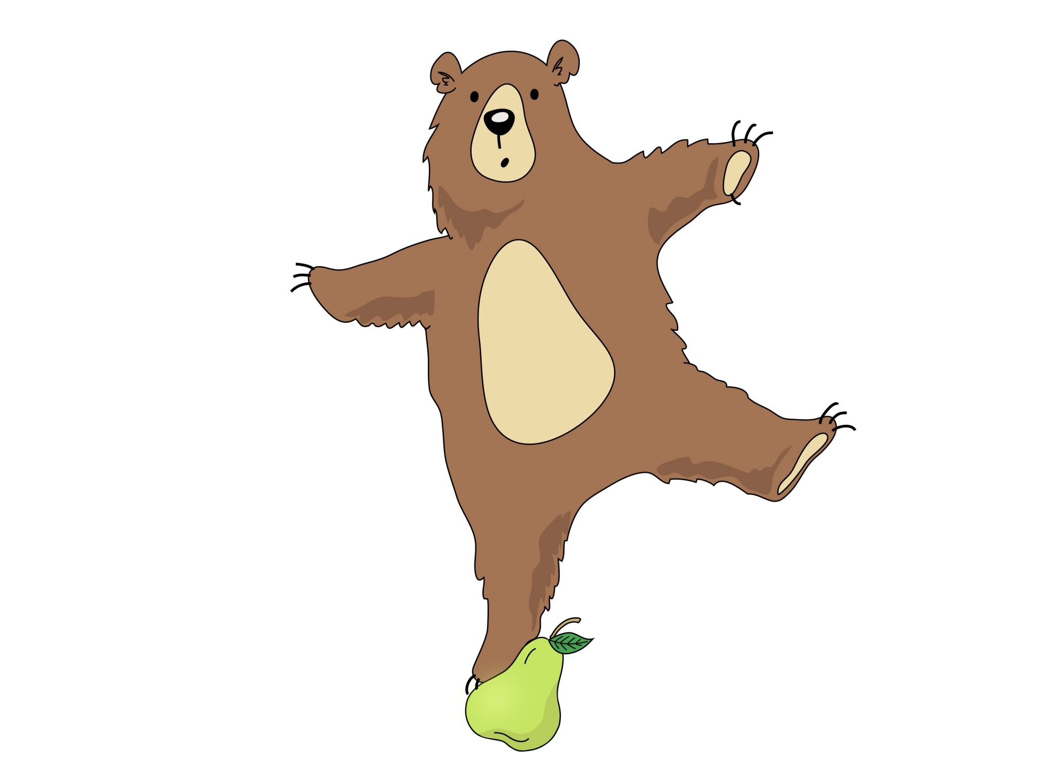

Bear on a pear ear ear ear

Slide 42
Skip to my lou my darling

Slide 43
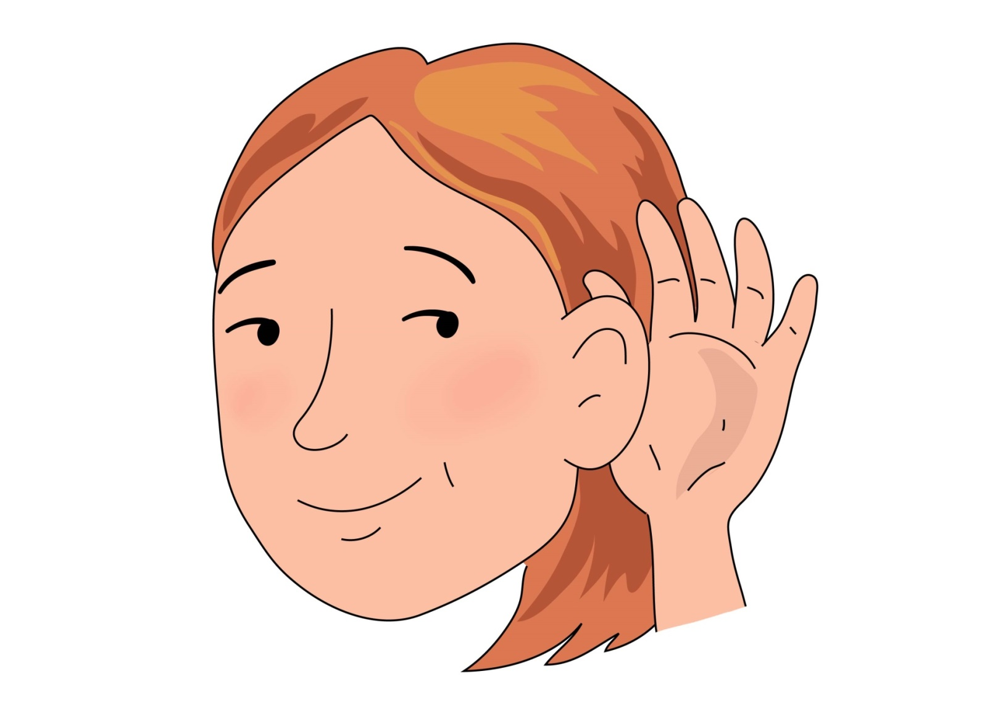
Hear with your ear
ear ear ear

Slide 44
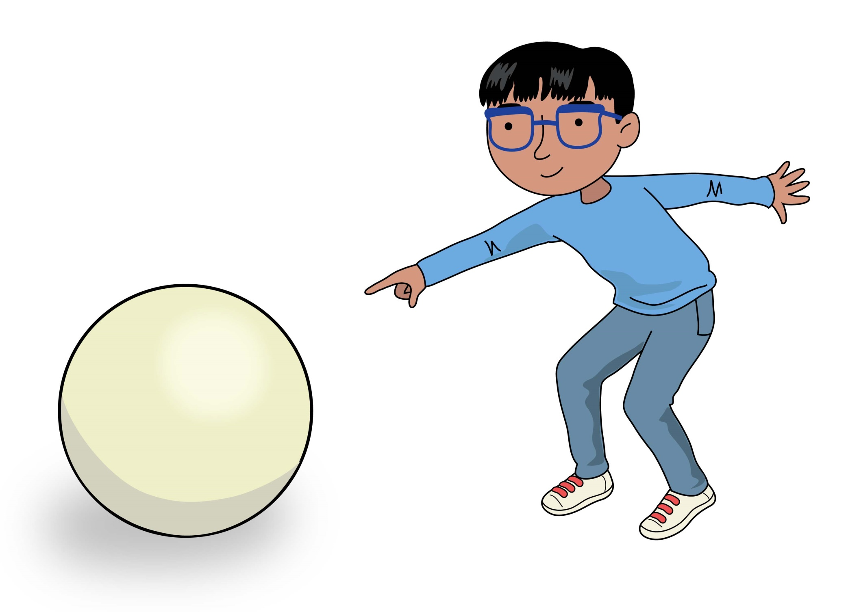
Look here it’s a sphere ere ere ere

Slide 45
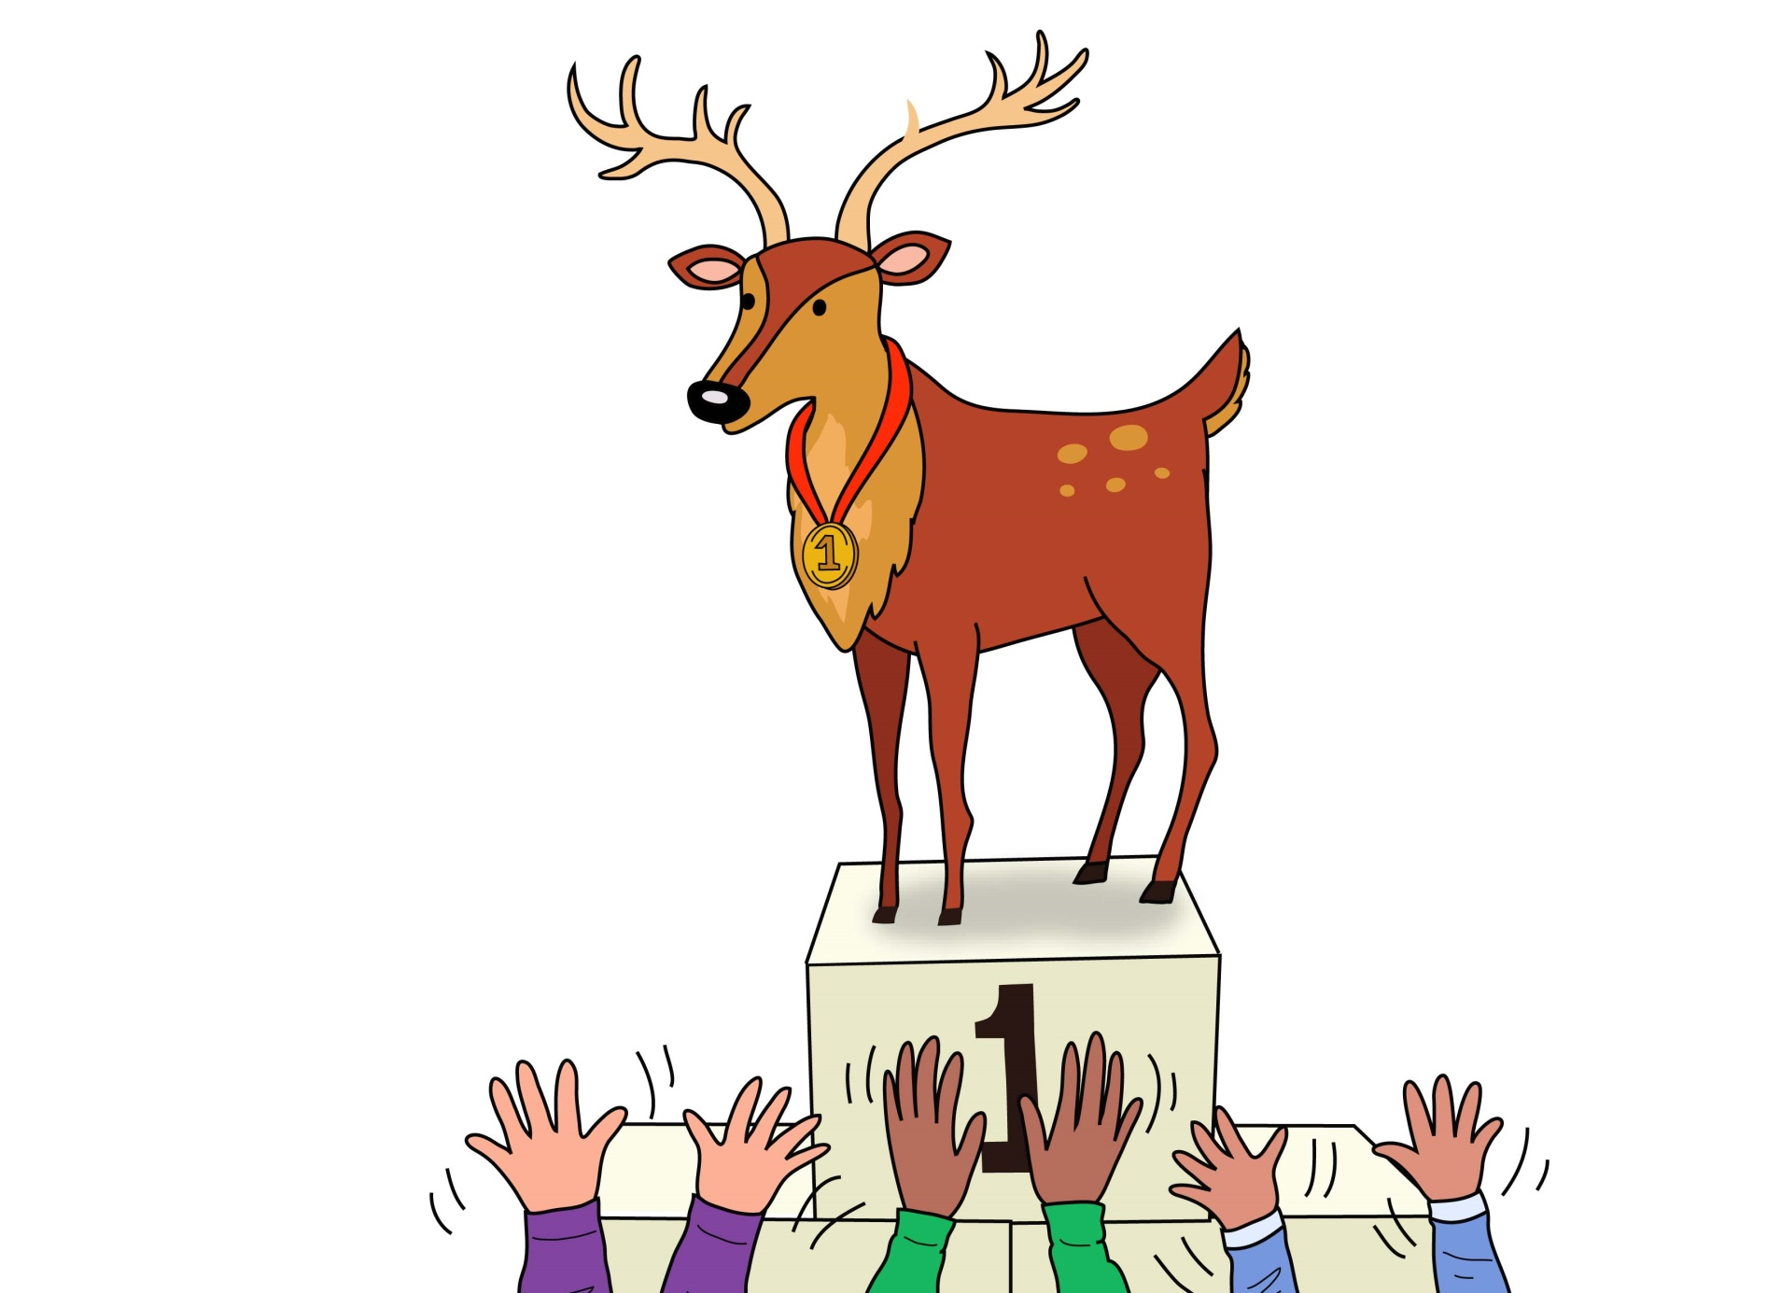

Cheer for the deer eer eer eer

Slide 46
Skip to my lou my darling

Slide 47
Now we’ve sung our song to you, you can learn to blend sounds too.

