Slide 1
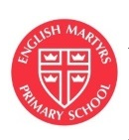
Welcome to Year 3!
Class Teacher: Mr Rondeau
Teaching Assistant: Mrs Ellmer

Slide 2
My door is always open - please email year3@englishmartyrs.school with any queries or we can talk after school.

Slide 3

The subjects we study are...
Religious Education
English (reading, writing, speaking and listening, handwriting, grammar, punctuation and spelling)
Maths (including times tables)
Science
Topic (History, Geography, Art and Design Technology)
Computing
Music
Physical Education
French
RSHE

Slide 4
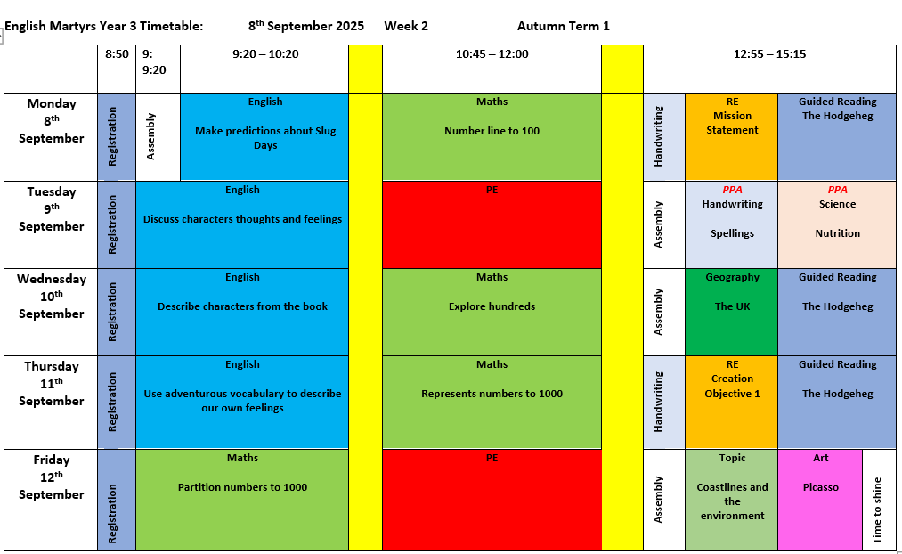

Slide 5
Year 3 Class Expectations
Always be kind and respectful to everyone
Listen carefully when someone is speaking
Always try your best
Look after our classroom and equipment
Please remember to put up your hand and not shout out

Slide 6

Our Topic this term is
Footprints in the sand...
We live in a world that offers outstanding beauty, contrasting landscapes and a diverse range of people and cultures. Through this topic we aim to develop our awe and wonder about the wonderful world in which we live, inspiring our curiosity and fascination of our local environment and deepening our understanding of our local coastal areas, Through our trip to Chichester Harbour we will undertake an in depth study of this area and investigate the answers to our questions to deepen our understanding further. We want to broaden our understanding of how we can make a positive impact on the world and we endeavour to understand that our life experiences can be shaped by where we live and the people that live there but that we are part of one world and that God’s earth needs protection and unity.
18th September - Trip to Chichester Harbour

Slide 7
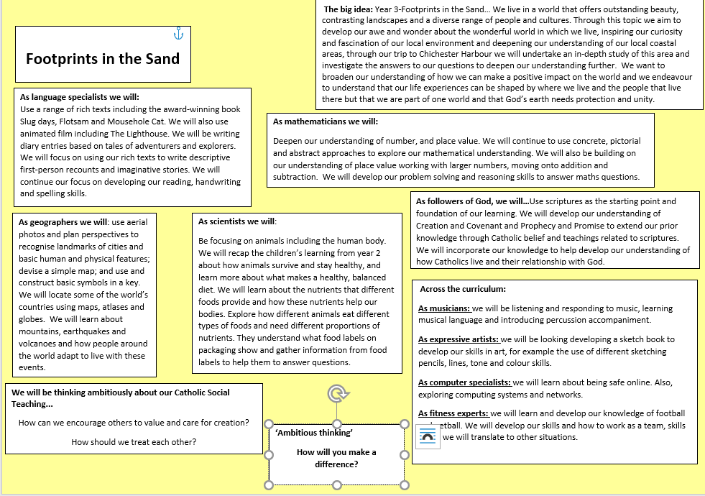
Autumn Term
Planner

Slide 8

Maths
The aims of the Maths curriculum are to ensure all pupils:
become fluent in the fundamentals of mathematics
reason mathematically using mathematical language
can solve problems by applying their mathematics to a variety of problems with increasing sophistication, including breaking down problems into a series of simpler steps and persevering in seeking solutions

Slide 9
Times Tables
Children need daily practice with their times tables in order to really remember them.
They only truly know them when they can fluently recall them out of order and when they can apply them in order to solve problems.
By the end of Year 3 children should know all of the multiplication and division facts for 2, 3, 4, 5, 8, 10.
The children will use Ipads every Friday afternoon to practice and timetables games on TT Rockstars.

Slide 10
End of Year Expectations for Year 3
Mathematics
• Count from 0 in multiples of 4, 8, 50 and 100; find 10 or 100 more or less than a given number.
•recognise the place value of each digit in a three-digit number (hundreds, tens, ones).
• Compare and order numbers up to 1000.
• Identify, represent and estimate numbers using different representations.
• Read and write numbers up to 1000 in numerals and in words.
• Add and subtract numbers mentally, including: a three-digit number and ones, tens and hundreds.
• Add and subtract numbers with up to three digits, using formal written methods of columnar methods
• Estimate the answer to a calculation and use inverse operations to check answers
• Solve problems, including missing number problems, using knowledge of number facts and place value.
• Recall and use multiplication and division facts for the 3, 4 and 8 multiplication tables (recognise multiples)
• Recognise, find and write fractions of a discrete set of objects: unit fractions and non-unit fractions with small denominators
• Measure, compare, add and subtract: lengths (m/cm/mm); mass (kg/g); volume/capacity (l/ml)
• Tell and write the time from an analogue clock, including using Roman numerals from I to XII, and 12-hour and 24-hour clocks

Slide 11

Reading
Once a week, we will hear your child read. This may be as part of a class read or 1:1. Children can change their books in any reading session.
We will have Whole Class Reading sessions 3 times a week. As a class we read one text and we answer questions about the text. We are currently reading The Hodgeheg.
Reading records will be signed and dated termly to track when and what your child has read, sometimes comments will be written, where needed.

Slide 12
End of Year Expectations for Year 3
Reading
• Use a full range of strategies to read fluently
• Read common prefixes and suffixes
• Start to discuss their understanding and explain the meaning of words in context.
• Use different strategies as well as background knowledge to explain meaning of words in a text
• Draw inference from across a paragraph referring to simple settings and characters
• Use events that has happened in the text to make an accurate prediction from a short passage.
• Discuss authorial choices and how words/phrases are used to create impact.
• Identify how language, structure and presentation contribute to meaning.
• Ask and respond to questions using evidence from a text.
• Retrieve and record information from fiction
• Locate information in non-fiction texts using a range of features; indexes, glossaries, contents pages, headings, tables, charts and diagrams.
• Skim and scan to locate key information, which may include highlighting and annotating a text.
• Identify the main ideas drawn from more than one paragraph and summarising using a short passage

Slide 13

English
- We will use rich texts to inspire our writing, such as the award winning book Slug Days, Flotsam and The Mousehole Cat to explore descriptive vocabulary and create character, setting and plot in narrative.
-WE will plan our writing by discussing writing similar to that which they are planning to write in order to understand and learn from its structure, vocabulary and grammar
- We will compose and rehearsing sentences orally (including dialogue), progressively building a varied and rich vocabulary and an increasing range of sentence structures
The children will start to organising paragraphs around a theme and in narratives, creating settings, characters and in non-narrative material, using simple organisational devices [for example, headings and sub-headings]

Slide 14

English
End of Year Expectations for Year 3
Writing
• Demonstrate an increasing understanding of purpose and audience.
• Begin to use paragraphs to organise ideas.
• In narratives, create settings, characters and plot.
• Begin to punctuate direct speech with inverted commas
• Use simple devices to structure the writing and support the reader e.g.. headings and sub-headings.
• Use a varied and rich vocabulary.
• Use conjunctions, adverbs and prepositions to show time, place and cause.
• Maintain the correct tense throughout.
• Assess the effectiveness of their own and others’ writing and suggesting improvements
• Proof read to check for errors and make improvements
• Use the range of punctuation taught in Year 2 and 3 mostly correctly
• Use of present perfect form of verbs.
• Spell some common exception words and some words from the Year 3 & 4 spelling list.
• Use ‘a’ and ‘an’ correctly • Use further prefixes and suffixes e.g. super-, anti-, auto-, dis-, mis-, -ly
• Correctly form letters and space words to produce neat legible handwriting with some joining.

Slide 15
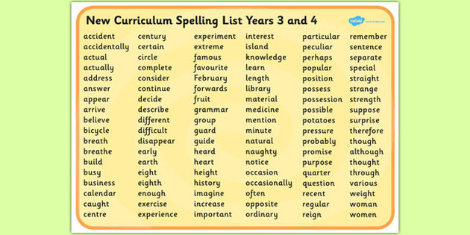
English

Slide 16
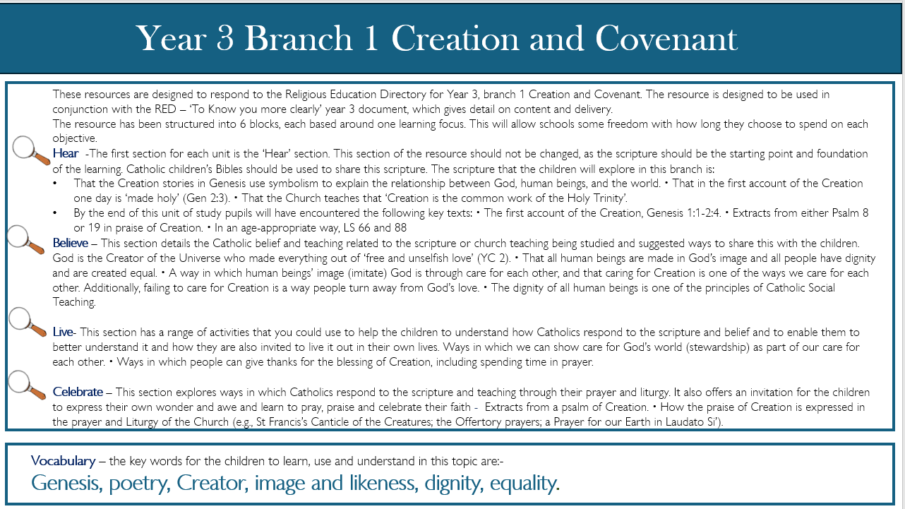
RE

Slide 17
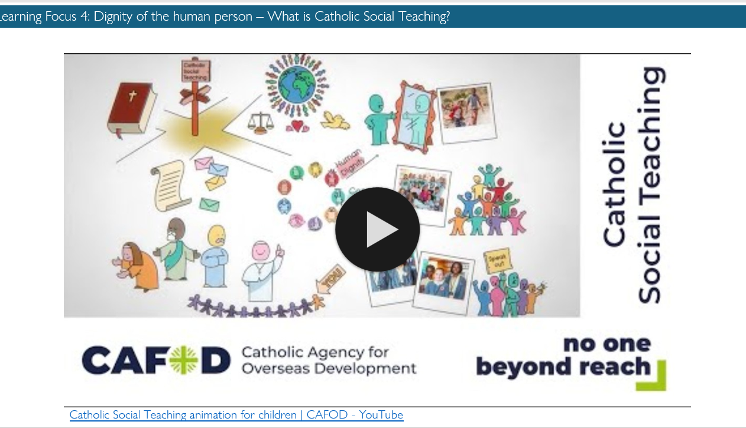
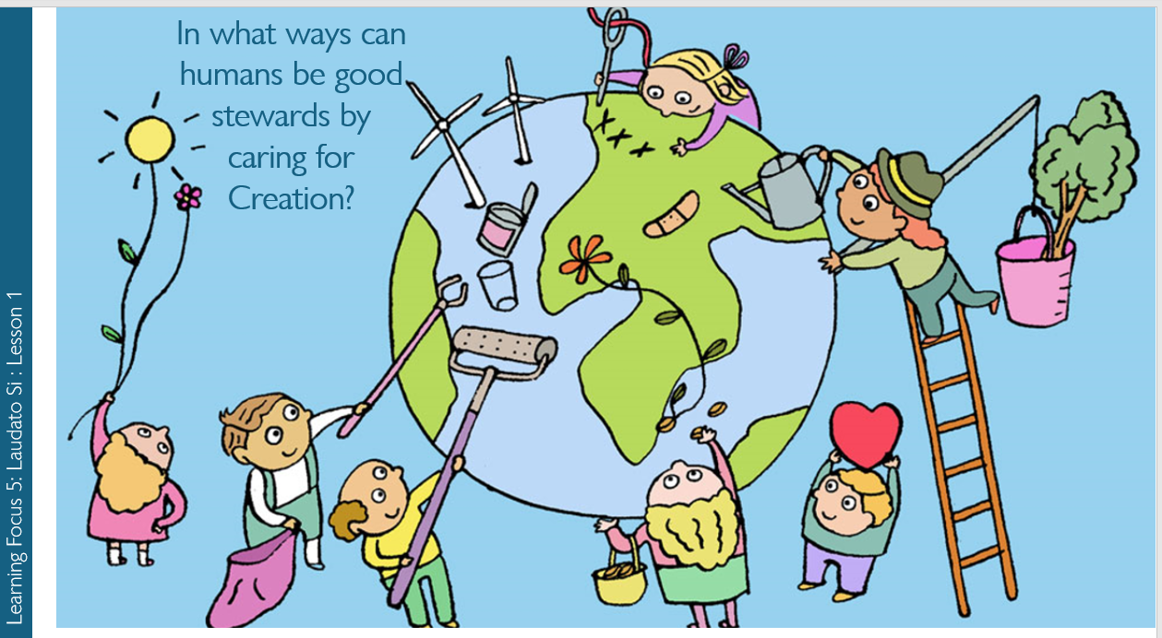
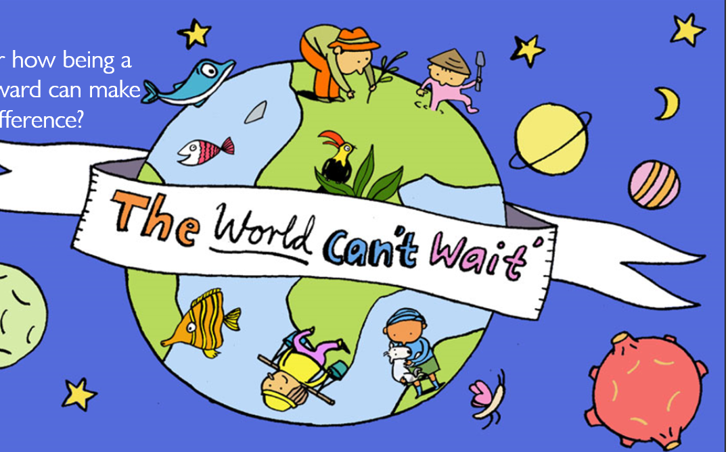

Slide 18

Homework
Read five times a week and record in reading record.
Practice times tables on TT Rockstars
Practice Spellings on Ed Shed and/or paper copies
Homework Grids.

Slide 19
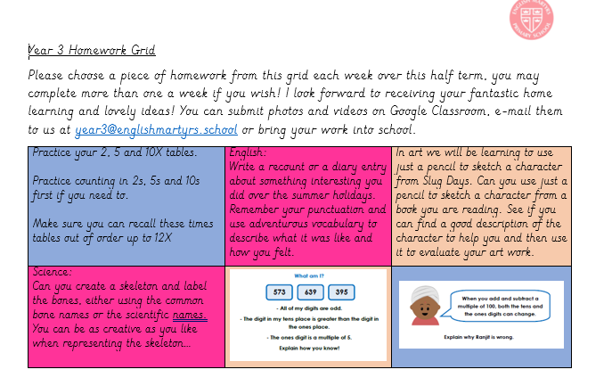
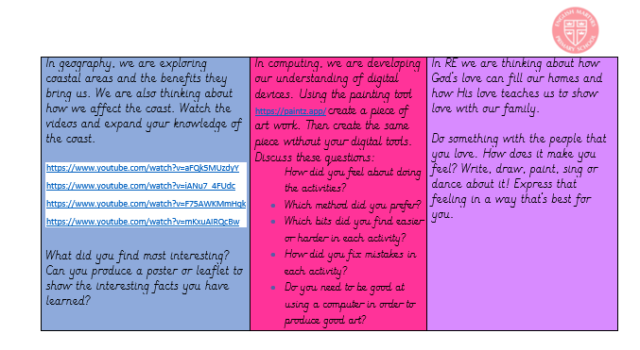
Home work grid here

Slide 20


Expectations
Children should become more independent with starting their work and finding ways to support their learning.
Children are expected to be more organised, with their lunch boxes, snacks, water bottles, etc.
PE is on Tuesdays and Fridays, and will come into school in their PE kits. (If it is their birthday on a PE day please send in their PE kit). Please ensure if children wear lace up trainers that they can tie their laces.
Children are encouraged to ask for help and to never give up
We expect the children to try their best
We want them to have fun!

Slide 21
Positive behaviour
In our school, we want to make sure that all of our children are supported and encouraged to be:
ready (to make the most of all opportunities in school and allow others to do the same)
respectful (to all members of the school and wider society)
safe (through showing protective behaviours towards themselves and others)
Learning about appropriate behaviours is like all learning in school – there are good days and not so good days. Some children will find it easy to follow behaviour expectations, others may require additional support and understanding.

Slide 22
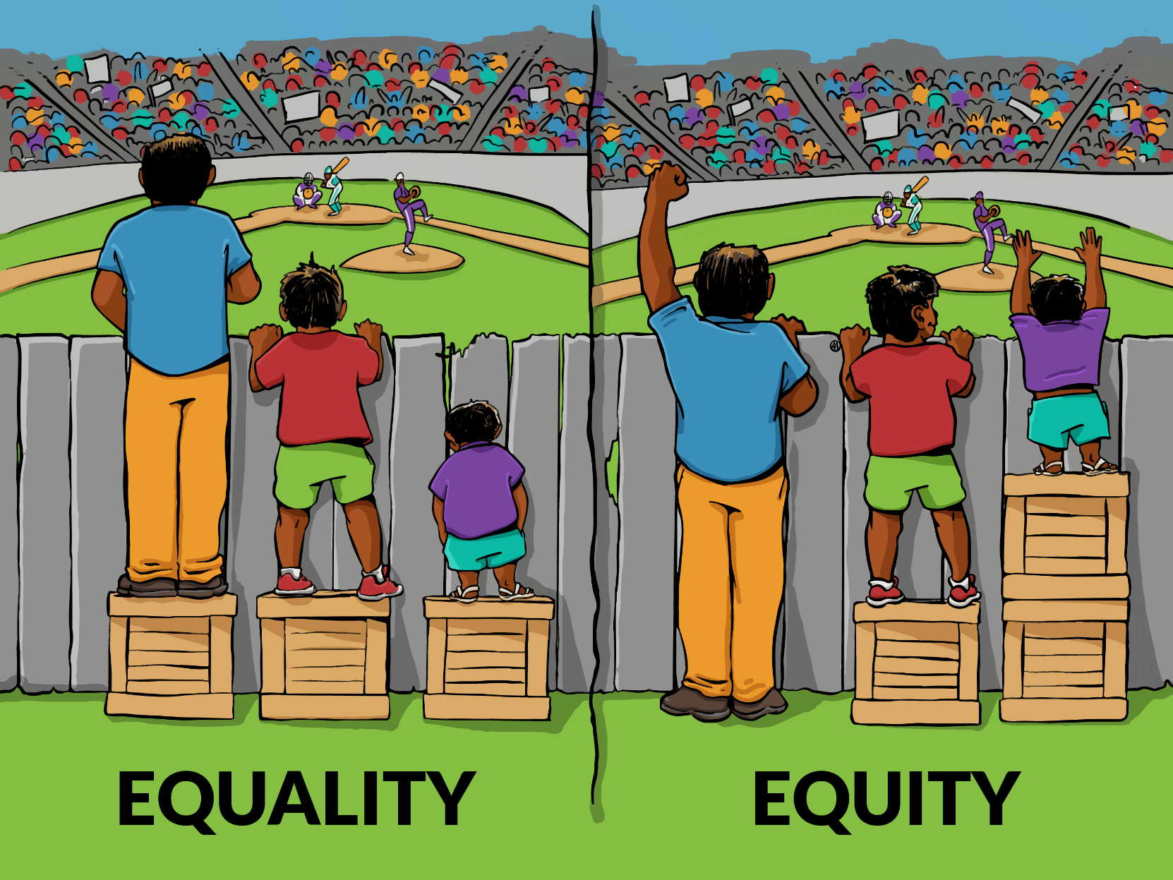
Our goal is not that children are treated equally but that they are treated with equity so that they can access opportunities, thrive and become the people that God intended them to be.
This may mean that some of our children may need more chances, more understanding, time out, shorter tasks, more patience and tolerance … as a Catholic school we are invested in every individual. There may be times that other children may perceive this as ‘unfair’ – “Why didn’t I get a box?” - but we are aiming towards developing a shared understanding across our school that true fairness is when everyone gets what they need.

Slide 23
All children come from different starting points in terms of behaving positively and consistently demonstrating this in school. As a society, we are increasingly aware of the additional strains that the experience of lockdown has placed on our children in developing their social behaviours and their window of tolerance.
This year we are going to be reviewing our Positive Behaviour policy. We want to do this with the children, all of the staff and governors and you as parents and carers.
If you would like to help us with this by being part of parent forums we would be grateful for your support and feedback. Please look out for emails and information in the school newsletter about this.
https://www.youtube.com/watch?v=Wcm-1FBrDvU&t=66s

Slide 24
Time to shine!
This is where one child is picked at random on a Friday.
As a class we will then discuss why we think this person ‘shines’.
The chosen person will then get to take home the ‘Time to Shine’ tote bag to collect things which they are proud of, or represent them from home.
On a Monday in assembly, they will be able to hear all the lovely things their friends have said about them, and throughout the week they will be able to show their bags to the class.

Slide 25
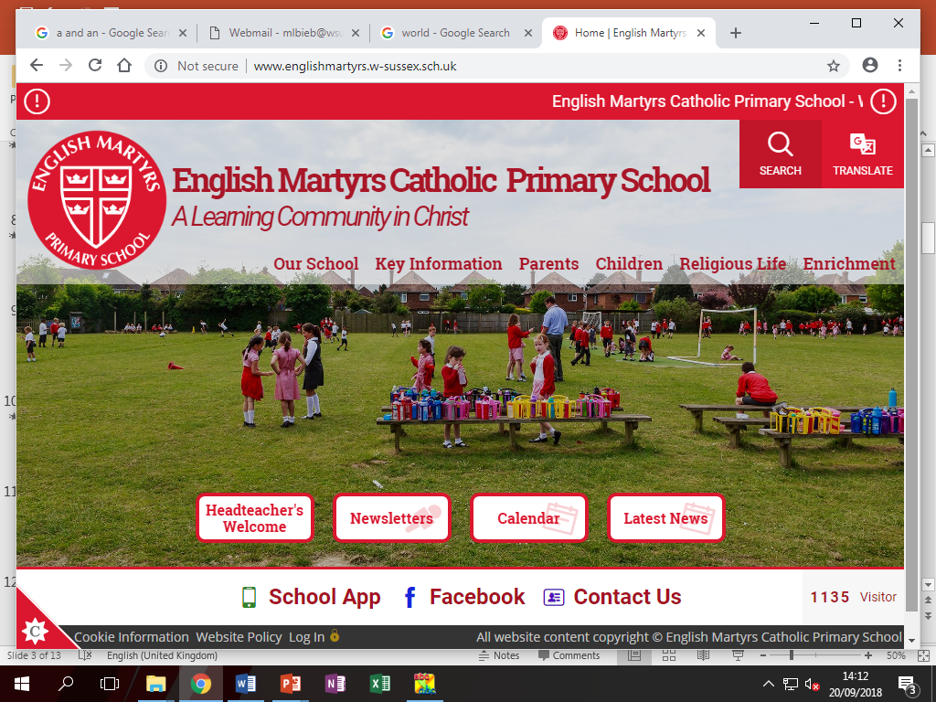
School Website
Please see the class page on the website for updates.
This PowerPoint slide will also be added.
http://www.englishmartyrs.w-sussex.sch.uk/

Slide 26
E-safety
We have got information on the website about keeping your child e-safe.
The start of the year is a good opportunity to sit down and have a talk with your child about being safe online, re-check all your parental settings. Please watch the video below for further information.
https://www.youtube.com/watch?v=sz4EyUMUTro

Slide 27

Any questions?
year3@englishmartyrs.school

