Slide 1

Miss O’Sullivan Class teacher
Mrs Collins Teaching Assistant
PPA Teacher/SENCO Mrs Jobbins

Slide 2

If you have any concerns, queries or anything you would like us to be aware of then please email our year 5 email address:
year5@englishmartyrs.school

Slide 3
Year 5
2025 – 2026
Autumn 1 | Earth and Space (Science-led)
Autumn 2 | The Fight for the Kingdom of England The Anglo-Saxons (History-led)
Spring | The Fight for the Kingdom of England The Vikings (History-led)
Summer | The Thrill of Brazil (Geography-led)

Slide 4

PE – Mondays
and Fridays
(children to wear
kit to school as before)
Water bottles
Reading
Books
Fruit
Needed everyday:
Reading records

Slide 5
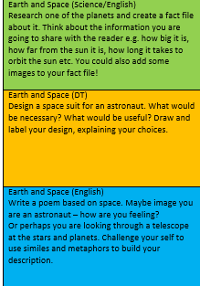
Year 5
2025 – 2026
Homework
This year, we will continue to use a half termly grid of tasks for weekly homework.
Children should choose one of the activities from the grid to complete and hand in each week.
All of the tasks on the grid are connected to different curriculum areas that relate to our learning for that half term.
We also have our TT Rock stars and Spelling shed memberships which are invaluable at teaching your child in a fun way. These activities are as well as the homework grid.
Homework is set to enhance and support your child's learning. It is part of the relationship between school and home aimed at helping your child achieve the best they can.

Slide 6
Year 5
2025 – 2026
Reading
We would love children to really enjoy reading! Please encourage your child to read every day - they can record it themselves in their record. It doesn’t have to be their school book, it could be a comic or a recipe, it all counts to their experiences. If they read to you, you can make comments in their record too. Don’t forget to ask questions about what they have read, for example, what has happened so far or their favourite character. Even free readers!

Slide 7
Year 5
2025 – 2026
Spellings - Investigative approach, looking at patterns/rules, exploring phonemes (sounds).
Practising at home on The Spelling Shed online. Assignments for spellings for that week. General practise too.
Year 3/4 and Year 5/6 - statutory word list.
Timetables - https://www.topmarks.co.uk/maths-games/7-11-years/times-tables
And TT Rockstars.

Slide 8
Positive behaviour
In our school, we want to make sure that all of our children are supported and encouraged to be:
ready (to make the most of all opportunities in school and allow others to do the same)
respectful (to all members of the school and wider society)
safe (through showing protective behaviours towards themselves and others)
Learning about appropriate behaviours is like all learning in school – there are good days and not so good days. Some children will find it easy to follow behaviour expectations, others may require additional support and understanding.

Slide 9

Our goal is not that children are treated equally but that they are treated with equity so that they can access opportunities, thrive and become the people that God intended them to be.
This may mean that some of our children may need more chances, more understanding, time out, shorter tasks, more patience and tolerance … as a Catholic school we are invested in every individual. There may be times that other children may perceive this as ‘unfair’ – “Why didn’t I get a box?” - but we are aiming towards developing a shared understanding across our school that true fairness is when everyone gets what they need.

Slide 10
Time to shine!
We will continue with ‘Time to Shine’.
This is where one child is picked. As a class we will then discuss why we think this person ‘shines’.
The chosen person will then get to take home the ‘Time to Shine’ tote bag to collect things which they are proud of, or represent them from home.
On a Monday, in assembly, they will be able to hear all the lovely things their friends have said about them. They will be able to show their bags to the class at some point in the week.

Slide 11
Year 5 classwork showcase
Please join your child in a showcase of their work on the following dates:
Autumn- Tuesday 18th November
Spring- Friday 6th February
Summer- Friday 5th June

Slide 12
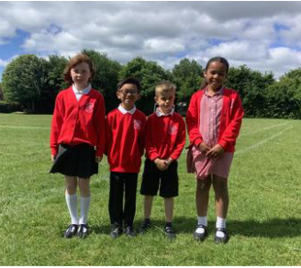
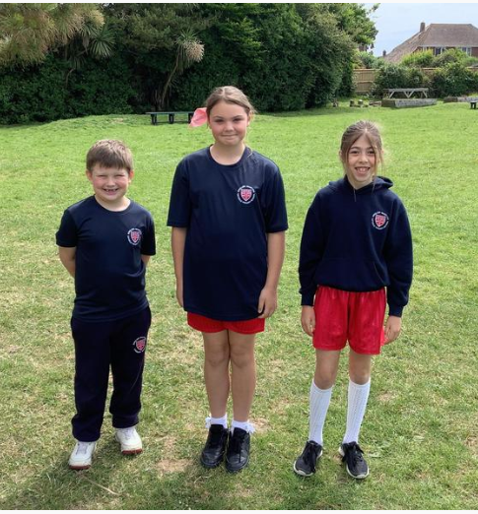
School uniform
Information about school uniform and the details of our supplier can be found on the website (under ‘Parents’ and ‘uniform’). Please note:
We have added a picture of what are considered appropriate ‘school shoes’ - boots are not included, and trainers should only worn on PE days
Longer hair should be tied back with simple hair accessories in the school colours
The school does not allow children to have hair styles that could be distracting for other children.
Earrings should be plain studs only
For PE, children should wear red PE shorts or navy jogging bottoms. Leggings, cycle shorts or tights underneath shorts should not be worn
If you have any queries about school uniform, please get in touch with Dr. Townsley via the school office.

Slide 13
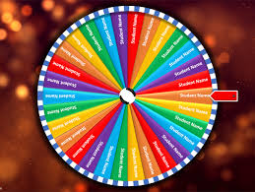
School uniform reward
We will be continuing with the ‘Wheel of Names’ where children wearing the correct uniform have a chance to win a treat of their choice (hot chocolate, smoothie or milkshake).
You’ve got to be in it to win it!

Slide 14

Attendance and Punctuality
We all want the very best for your child, and for us to do our best for them they need to be here as often as possible and to be punctual. This is such an important time in their lives, and the odd absence here or there can create gaps in learning that really do have an impact.
There is new government guidance on attendance this year, and the school policy on the website has been updated in line with this. Key things to note are that:
You should try to book any medical appointments for your child (e.g. optician, dentist) out of school time. Proof of appointment times should be sent in with the request.
All requests for absence or time out of school for appointments should be made via an absence request form.
Family holidays in term time will not be authorised and if a child has more than 10 sessions of unauthorised absence in 10 weeks, referrals will be made for Fixed Penalty Notices.
Gates are closed and the register is taken at 8.50. If your child is late, they must be taken to the office by an adult to sign them in.

Slide 15

Attendance and Punctuality
We are really proud of our high attendance rates at English Martyrs. We are consistently above national averages for our attendance and this tells us that children are happy to come to school and are consistently accessing the education that they need for their future.
We are here to help with attendance and punctuality, so if you need any support then please don’t struggle in silence, get in touch with your class teacher or with Dr. Townsley / Mrs. Theophilus and we will look at what we can do to help.

Slide 16


Safeguarding
In our school community, we are all fully committed to safeguarding your children so that they can thrive and achieve their full potential.
The start of the school year is a great time to talk to your children about keeping themselves safe and to discuss keeping themselves safe online and to check that their activities online are safe and age-appropriate.
The NSPCC has some great resources for parents, from the PANTS campaign (with the wonderful Pantosaurus song) to the Be Share Aware campaign. internetmatters.org is also a great starting point with an ABC online safety checklist and age specific advice. If you need any further advice, please do ask us.

Slide 17
E-Safety
It is important to keep your children up to date with the importance of E-safety and provide them with information on how to stay safe online.
Your children have learnt about this already at school and will be doing more this term and beyond. Please to do speak to them about it at home.
All children have talked about a safe adult they can talk to if something upsets them or they are worried.

Slide 18
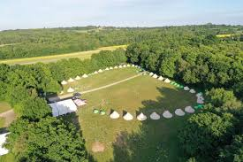
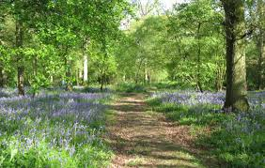
Year 5 Residential
Thursday 2dn July- Friday 3rd July 2026
Blacklands Farm- Camping
Wheatsheaf Rd, Henfield BN5 9AT

Slide 19

year5@englishmartyrs.school
School website – Children – Class pages – Year 5

