Slide 1


Mr Neve - Class Teacher
Teaching Assistant – Mrs Whattingham

Slide 2

If you have any concerns, queries or anything you would like us to be aware of then please email our year 6 email address:
year6@englishmartyrs.school

Slide 3
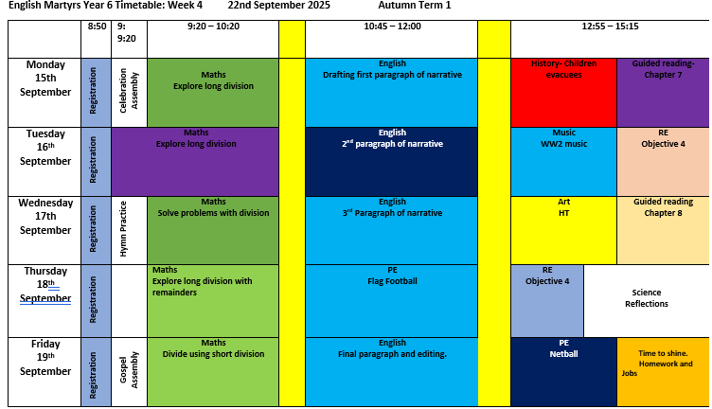

Slide 4
Our Topic this term is World War II
The children will learn when and why World War II began and find out about the key individuals and countries
involved through a cross-curricular approach.
English
The children will watch animated films (Beyond the Lines, The Piano) and study a range of texts to help write in
first person narratives, character diary entries and write poems based on Remembrance Day.
We will incorporate additional engaging, high quality literature texts in our whole class reading.
History / Geography
In our History and Geography lessons, they will research historic events such as the Battle of Britain and study the
human and physical geography of our local area of Sussex.
In addition to this, the children will discover all about evacuation; learn what it was like to live with food rationing
and explore the contribution made by women to the war effort through film and a series of texts. The children will
investigate events that were key turning points in the war.
Studying World War II will help children to develop their investigation and evaluation skills; learn to organise
information chronologically and understand how past events have helped to shape the world we know today.
Music
The children will research how music and entertainment played a vital role during the war and focus on
influential singers including Dame Vera Lyn, learn about dances brought over from America.
Additionally, they will learn about the vital role of the wireless and dance halls.

Slide 5
Our Topic in the Spring Term is The Mayan Civilisation
Mysteries of the Maya
We will open up a world of contrasts and connections between the vibrancy and diversity of modern-day Mexico and the history of the Maya people. We will reflect on the sophistication and beliefs of the ancient Mayan civilisation, and explore their history and surroundings. We will explore the tradition of the Day of the Dead and how this is now celebrated in modern Mexican society.
Our Topic in the Summer Term is Identity
Identity
As we come to the last term of the children’s English Martyrs journey, this is a time for reflection. Through exploring the idea of ‘What makes me, me?’, children will consider their own experiences, how these shape opinions and how to value and appreciate viewpoints of others. This topic also encompasses our Year 6 residential trip. Our journey will have gone full circle; Early Years children start by learning about how they are unique so we now support children’s transition by celebrating how far they have come and how much they have to offer.
The children will write their own autobiographies and we will publish them.

Slide 6
English
The aims of the English curriculum are to ensure all pupils:
identify the audience for and purpose of the writing
noting and developing initial ideas by drawing on reading and previous texts
draft and write by selecting appropriate grammar and vocabulary,
understanding how their choices can change and/or enhance meaning
describe settings, characters and atmosphere
use dialogue to convey character and advance the action
use a wide range of devices to build cohesion within and across paragraphs
evaluate and edit their work
proofread for spelling and punctuation errors

Slide 7

Discuss and develop ideas; routinely use the drafting process before and during writing.
Adapt form and style to suit purpose and audience; draw appropriate features from models of similar writing.
Use paragraphs to develop and expand some ideas in depth; add detail within each paragraph; coverage may not always be even.
Use a range of devices to link ideas within and across paragraphs e.g. adverbials or repetition of a phrase.
Use a range of presentational devices, including use of bullet points, tables and columns, to guide the reader.
Integrate dialogue to convey character and advance the action.
Describe characters, settings and atmosphere, with some precision.
Summarise longer passages, when required.
Evaluate own and others’ writing; proof read, edit and revise.
Write a range of sentence structures (simple and complex) including relative clauses e.g. using ‘that’, ‘which’.
Use a wide range of punctuation including brackets and dashes; commas for pauses; colons and semi-colons for lists; hyphens; consistent use of bullet points.
Use modal verbs to indicate degrees of possibility.
Maintain correct tense; also control perfect form of verbs e.g. He has collected some shells.
Understand and use active and passive voice.
Identify the subject and object.
Identify synonym and antonym.
Select vocabulary and grammar to suit formal and informal writing.
Use vocabulary which is varied, interesting and precise.
Use a dictionary and thesaurus to define words and expand vocabulary.
Writing is legible and fluent.
Correct choice is made about whether to join handwriting or print letters e.g. to label a diagram
End of Year Expectations
Writing

Slide 8
Reading
This half term, our class book is The Last Bear by Hannah Gold. I read to the
children every day and ask inference, retrieval and prediction questions
throughout the session.
We are using the book as part of our whole class Reciprocal Reading. This
is a way of improving reading comprehension through a structured
conversation about the text. It involves a dialogue between myself and
the pupils for the purpose of jointly constructing the meaning of a text.
Please can you encourage your children to read every night and talk about
vocabulary, characters and the story settings.

Slide 9
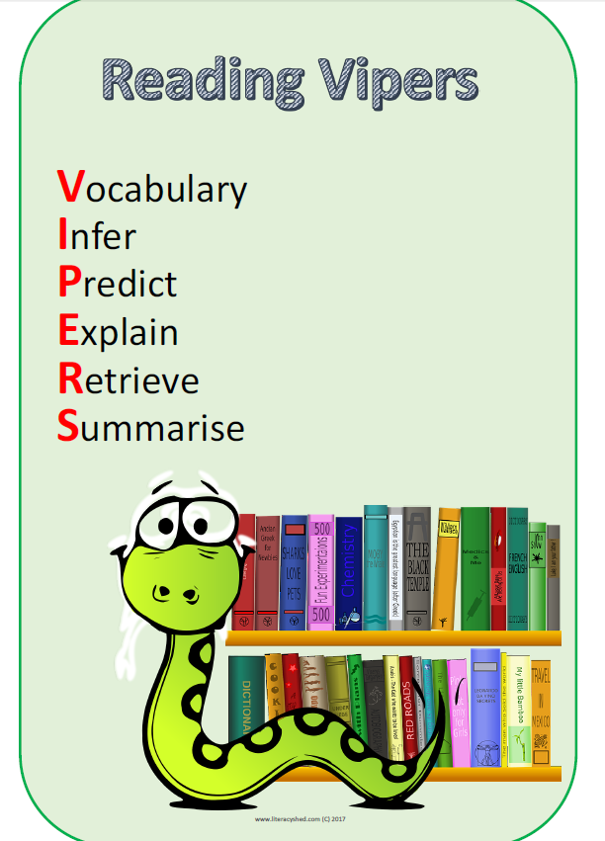
Demonstrate a positive attitude by frequently reading a wide range of texts for pleasure, both fiction and non-fiction.
Show familiarity with different text types which include modern fiction and fiction from our literary heritage; books from other cultures; myths, legends and traditional stories; poetry, plays and a range of non-fiction texts.
Recommend books to others, giving reasons for their choices; state preferences.
Accurately identify and comment on the features, themes and conventions across a range of writing, and understand their use.
Demonstrate that they have learned a wide range of poetry by heart.
Identify language, structural and presentational features in texts (e.g. columns, bullet points, tables) and explain how they contribute to meaning.
Use contextual evidence to make sense of the text; explore finer meanings of words; show, discuss and explore their understanding of the meaning of vocabulary in context.
Identify the effect of language, including figurative; explain and evaluate its effect
During discussion, ask pertinent questions to enhance understanding.
Make accurate and appropriate comparisons within and across different texts.
Make developed inferences e.g. characters’ thoughts and motives, or identify an inferred atmosphere; explain and justify with textual evidence to support reasoning; make predictions which are securely rooted in the text.
Distinguish between fact and opinion.
Retrieve, record and present information from non-fiction texts.
Identify key details which support main ideas; summarise content drawn from more than one paragraph.
Participate in discussion about books, expressing and justifying opinions, building on ideas, and challenging others’ views courteously.
Explain their understanding of what they have read, including through formal presentation and debates, maintaining a focus on the topic
End of Year Expectations
Reading

Slide 10

Maths
The aims of the Maths curriculum are to ensure all pupils:
become fluent in the fundamentals of mathematics
reason mathematically using mathematical language
can solve problems by applying their mathematics to a variety of problems with increasing sophistication, including breaking down problems into a series of simpler steps and persevering in seeking solutions

Slide 11
Year 6
2025-2026
Use negative numbers in context and calculate intervals across zero
Compare and order numbers up to 10, 000, 000
Identify common factors, common multiples and prime numbers
End of Year Expectations
Maths
Round any number to a required degree of accuracy
Identify the place value of each digit to 3 decimal places.
Use knowledge of order of operations to carry out calculations involving four operations
Multiply 4 digits by 2 digits
Divide 4 digits by 2 digits
Add and subtract fractions with different denominators and mixed numbers
Multiply and divide fractions and write answers in the simplest form
Calculate the percentage of a whole number

Slide 12

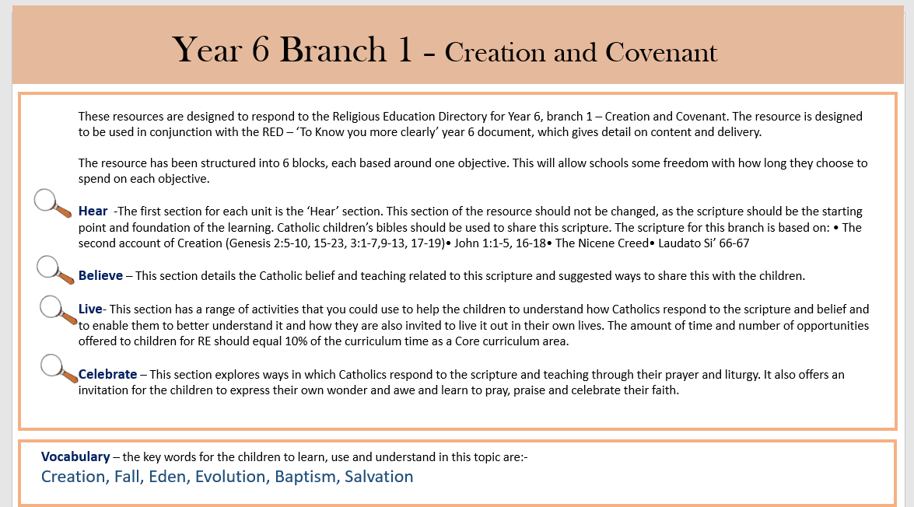
Religious Education
Branch 1
Year 6 Autumn Term 2025

Slide 13
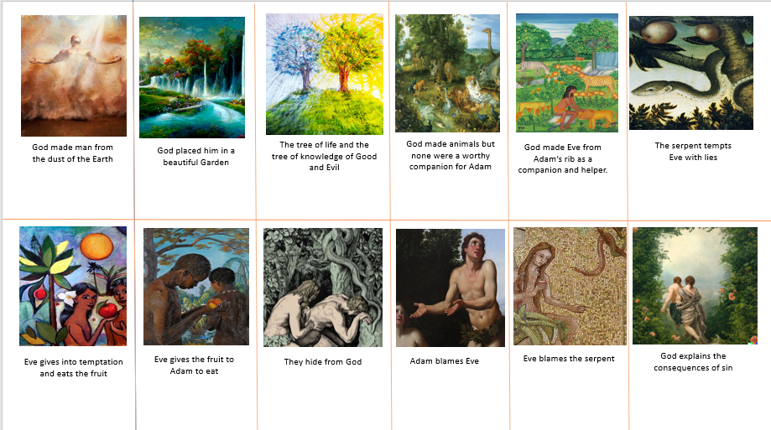
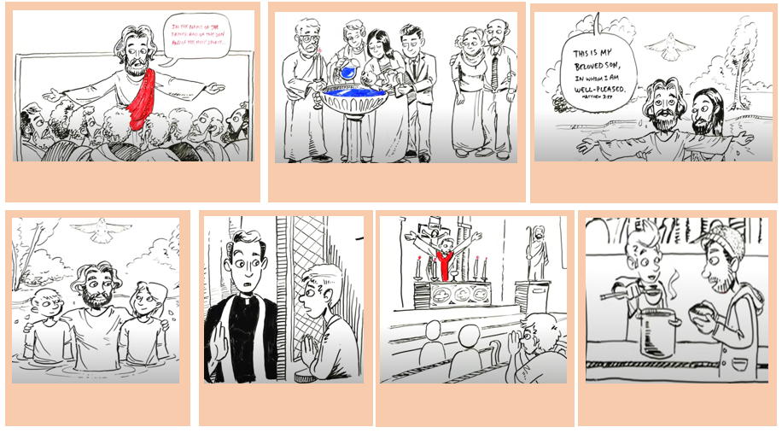
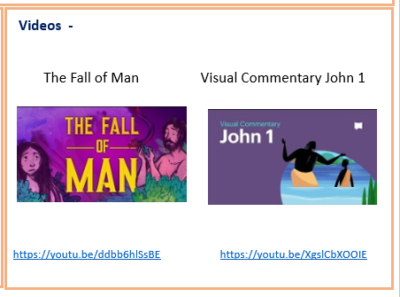

Slide 14
Year 6 Class Expectations
Be respectful to everyone in class and across the whole school.
Be a positive role model.
Persevere when learning gets difficult or challenging - show a growth mindset.
Become more independent with starting their work and finding ways to support their own learning....but remember we are here to help.
Be more organised with their lunch boxes, snacks, water bottles, etc.
Follow our school values

Slide 15

Homework
Both Maths and English tasks to be set on Friday to be returned on the following Thursday and should take approximately 20 - 30 minutes.
Homework will be set from SATs books and additional texts.
If your child can not complete their homework, please can you email me. I am also available on a Monday lunchtime to go through any questions.
Homework will be related to what the children are working on in class.

Slide 16


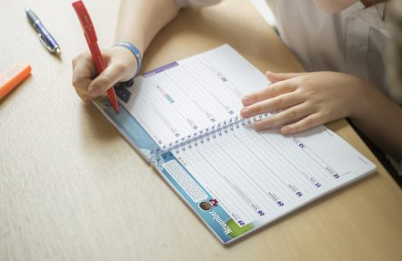
Red shorts
White tops
Navy, plain jogging bottom
Navy fleece/jumper
Needed everyday:
Thursday and Friday
(children to wear
kit to school)
Reading
books
Planners

Slide 17
SATs Week 2025
Monday 11th May 2026 – Grammar, Punctuation & Spelling – Paper 1 and Paper 2
Tuesday 12th May 2026 – English Reading Paper
Wednesday 13th May 2026 - Maths Paper 1 (Arithmetic)
Maths Paper 2 (Reasoning)
Thursday 14th May 2026 - Maths Paper 3 (Reasoning)
The KS2 Reading SATs:
This is one paper, with questions that are based on 3 different passages of text. Pupils will have 1 hour to complete the paper.
The KS2 Grammar, Punctuation and Spelling (GPaS) SATs:
There is a 20 word aural spelling test which should last around 15 minutes.
There is also a written element which consists of an English grammar and punctuation paper, which will last for 45 minutes.
The KS2 Maths SATs:
There will be 3 mathematics papers.
Paper 1 is an arithmetic paper which will last for 30 minutes.
Papers 2 and 3 are reasoning papers which will last for 40 minutes each.

Slide 18
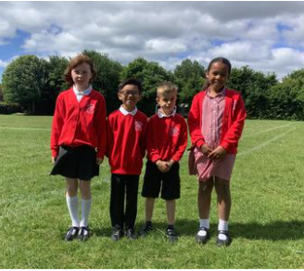
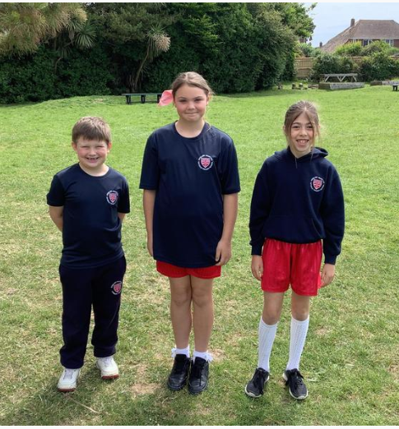
School uniform
Information about school uniform and the details of our supplier can be found on the website (under ‘Parents’ and ‘uniform’). Please note:
We have added a picture of what are considered appropriate ‘school shoes’ - boots are not included, and trainers should only worn on PE days
Longer hair should be tied back with simple hair accessories in the school colours
The school does not allow children to have hair styles that could be distracting for other children.
Earrings should be plain studs only
For PE, children should wear red PE shorts or navy jogging bottoms. Leggings, cycle shorts or tights underneath shorts should not be worn
If you have any queries about school uniform, please get in touch with Dr. Townsley via the school office.

Slide 19

Attendance and Punctuality
We all want the very best for your child, and for us to do our best for them they need to be here as often as possible and to be punctual. This is such an important time in their lives, and the odd absence here or there can create gaps in learning that really do have an impact.
There is new government guidance on attendance this year, and the school policy on the website has been updated in line with this. Key things to note are that:
You should try to book any medical appointments for your child (e.g. optician, dentist) out of school time. Proof of appointment times should be sent in with the request.
All requests for absence or time out of school for appointments should be made via an absence request form.
Family holidays in term time will not be authorised and if a child has more than 10 sessions of unauthorised absence in 10 weeks, referrals will be made for Fixed Penalty Notices.
Gates are closed and the register is taken at 8.50. If your child is late, they must be taken to the office by an adult to sign them in.

Slide 20
Attendance and Punctuality
We all want the very best for your child, and for us to do our best for them they need to be here as often as possible and to be punctual. This is such an important time in their lives, and the odd absence here or there can create gaps in learning that really do have an impact.
There is new government guidance on attendance this year, and the school policy on the website has been updated in line with this. Key things to note are that:
You should try to book any medical appointments for your child (e.g. optician, dentist) out of school time. Proof of appointment times should be sent in with the request.
All requests for absence or time out of school for appointments should be made via an absence request form.
Family holidays in term time will not be authorised and if a child has more than 10 sessions of unauthorised absence in 10 weeks, referrals will be made for Fixed Penalty Notices.
Gates are closed and the register is taken at 8.50. If your child is late, they must be taken to the office by an adult to sign them in.

Slide 21


Safeguarding
In our school community, we are all fully committed to safeguarding your children so that they can thrive and achieve their full potential.
The start of the school year is a great time to talk to your children about keeping themselves safe and to discuss keeping themselves safe online and to check that their activities online are safe and age-appropriate.
The NSPCC has some great resources for parents, from the PANTS campaign (with the wonderful Pantosaurus song) to the Be Share Aware campaign. internetmatters.org is also a great starting point with an ABC online safety checklist and age specific advice. If you need any further advice, please do ask us.

Slide 22

Any questions?
My door is always open - please come and see us with any
queries or please feel free to email. I am always available to
contact.
year6@englishmartyrs.school

