Slide 1


Teaching Team – Mrs Dennehy – Mon-Wed
Mrs Magwidi – Wed – Friday
Mrs DeLuca Smith - Wed morning
Miss Boutwood and Mrs Whattingham

Slide 2

We have had a wonderful start to our school year. Your children have been positive and engaged. They are working purposefully within the environment and being kind to one another.

Slide 3

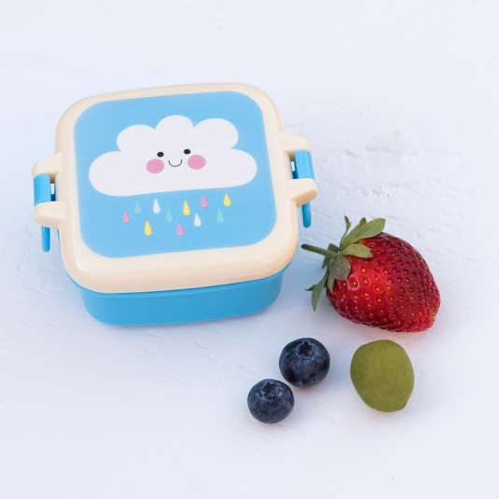

Reading Book
and Reading Record
Needed everyday:
Healthy snack
We have an afternoon snack time too.
Tuesday and
Thursdays
Named water bottle
Wellies and waterproofs.

Slide 4
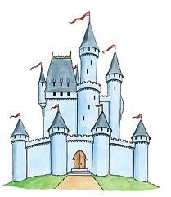
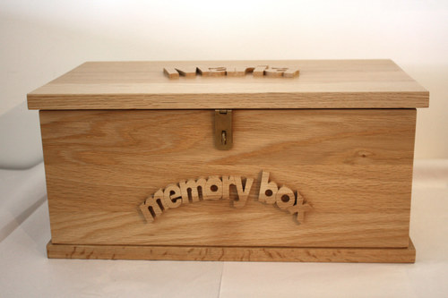
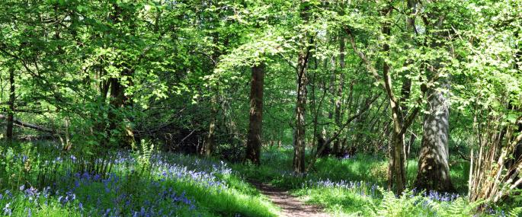
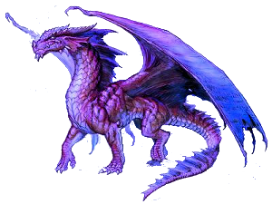
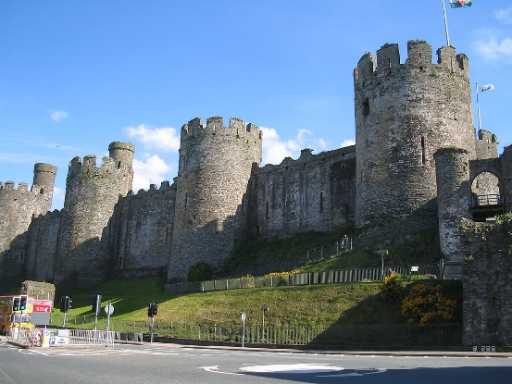
Our topics:
Memory box
Enchanted Woodlands
Scales and Stone

Slide 5
Our Trips/events:
Autumn Term
A walk to the post box and a teddy bears picnic.
Spring Term
English Martyrs Church visit
Woodland Sessions
Summer Term
WWT Trip

Slide 6
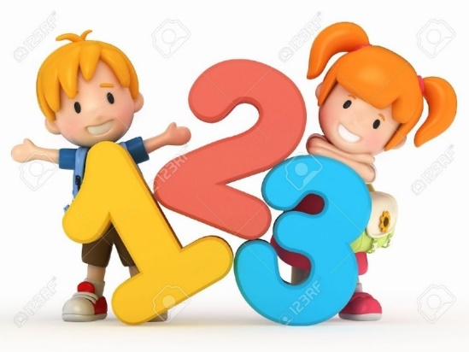

Our week:
Maths
English
Daily Phonics
Reading - 3x week group read with an adult
Handwriting/Fine Motor skills activities
PE - Tuesday and Thursday.
RE
Computing, Science, Music, RSHE weekly
Geography/History, Art/DT in half termly blocks.
Continuous provision throughout

Slide 7

The children have been assessed over the past two weeks.
We are recapping gaps before moving on.
We are going to trial e-books - more info to follow.

Slide 8
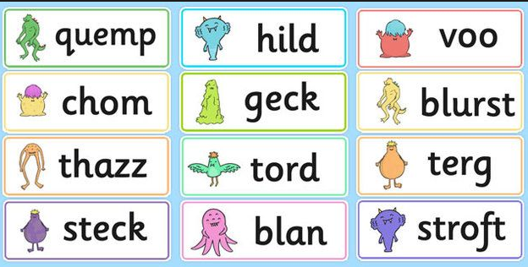
Alien words are a new concept for Year 1.
Children will have a phonics screening check in June. This is made up of 40 real and alien words.

Slide 9

Little Wandle - Letters and Sounds Year 1 Phonics Home Learning
Phase 3 & 4 (review) / Phase 5 - Autumn 1 Week 1 Focus - Review Phase 3 phonemes
Please support your child to practise and reinforce the phonemes and graphemes we are learning in school. More information and support can be found on the Little Wandle website -
https://www.littlewandlelettersandsounds.org.uk/resources/for-parents/
Phonemes we will be focusing on this week in school -
ai | ee | igh | oa
oo | ar | or | ur
oo | ow | oi | ear
We will be reading and writing words. Can you see this week’s focus phonemes?
tail | feel | right | road
food | bar | born | surf
down | join | near | soap
We will be reading and writing sentences. Can you spot any tricky words? Can you see this week’s focus phonemes? Can you read these sentences fluently?
The toads feel so cool.
The boot on my right foot is too hard.
I can see foxes in the car lights.
We can go down to the town on the bus.
We will be practising tricky words. Can you spot the tricky part of the word?
no | go | so | my | by
to | into | out | the
We will be spelling words. Can you write these words? Can you use the correct phonemes?
right | hard | took | hear

Slide 10
Home learning:
Regular reading at home is crucial.
Scheme book or e-book
Sharing book
Weekly phonics homework
Maths – we will send out half termly activities based on what we have been learning in school for you to practice with your child at home.

Slide 11


And finally…Please email us via year1@englishmartyrs.school or contact us on Tapestry with any queries or worries.
We’re looking forward to a fantastic year!

